Slide 1
Neural Networks
CSCI 601-471/671 (NLP: Self-Supervised Models)
https://self-supervised.cs.jhu.edu/sp2025/

Slide 2
How was HW1
With a show of hand, which one best applies to you:
It was smooth sailing through things I knew; my hamster nearly finished it.
it was familiar stuff but I had to learn or refresh a few things.
It was like shoveling snow in the middle of a blizzard, it just kept getting worse
It was so challenging, it felt like climbing Mount Everest with slippers on.
Notes:
Option 2 is the target level.
We will have 6 more assignments with similar caliber to make sure that y

Slide 3
HW2 is released
Did you see it?
Due Tuesday noon.
Feels like a long time away? it’s due in 120 hours!

Slide 4
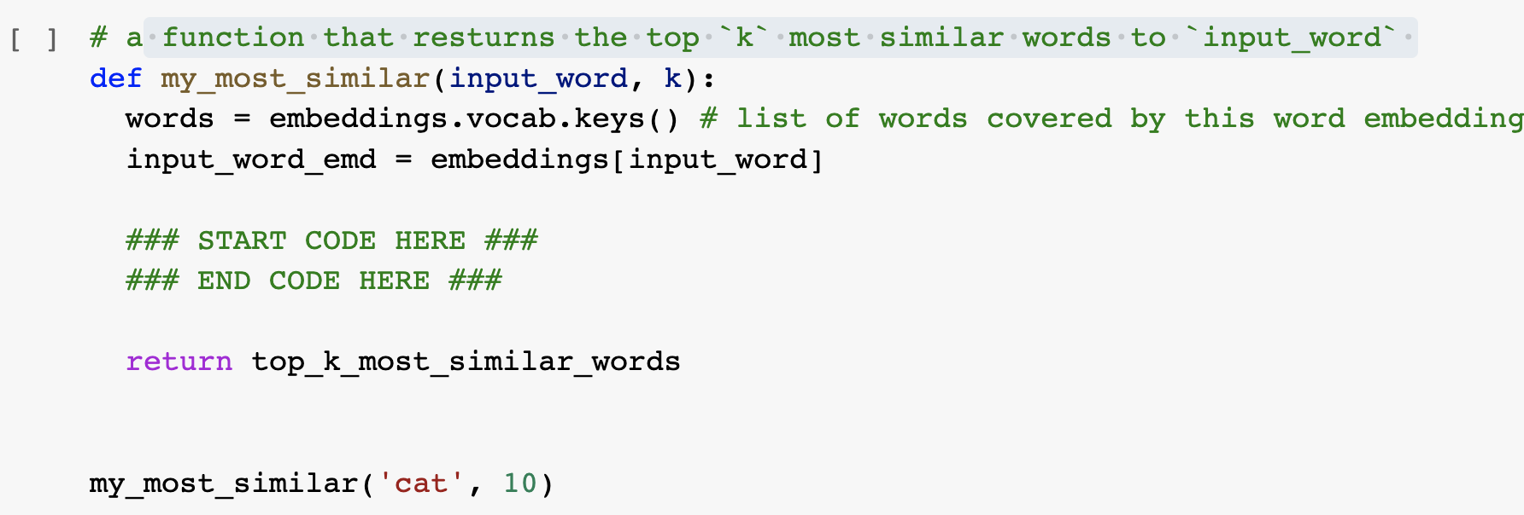
“Can I use external libraries?” No, unless specified!
Use the basic Python functions (no external libraries), unless explicitly specified.
In almost all places, you’re not expected to write more than 3-4 lines of code.

Slide 5
“I can’t install ….”
Current code is based on 3.6.0.
If you use other version, you might need to make minor changes to Gensim functions. Feel free to consult with Gensim documentation.
This is part of any programming experience. It's part of the job! Don't hate it, embrace it! 🤗

Slide 6
Recap: Language Modeling
Language Modeling: estimating distributions over language.
One approach we previously saw: counting word co-occurrences.
Pro: easy — just count!
Con: difficult to scale to longer context due to the sparsity challenge.
Another approach:
Using a learnable function that can estimate word transition probabilities.
Now: What are these learnable functions and how can we train them.
Notes:
We should probably start with a recap of what we've learned so far. Last time, we discussed language modeling, which we defined as the task of estimating some distribution over natural language. We aim to build a probabilistic model that predicts what will happen within a context of natural language. The first language model we learned about was based on counting word co-occurrences given a context of length n or n-1. We wanted to see the transition probability to the next token. We observed that while this method is easy to compute over large sets of documents, it doesn't scale well to longer contexts due to sparsity issues. The longer the context, the sparser the frequencies become, which means they don't capture long-range dependencies. This is a problem for natural language understanding because what we say now often depends on what we said earlier.
The alternative we considered was moving away from just counting and using statistical models to learn transition probabilities between contexts and the next token. This brought us to the question of what these learnable functions are and how we can train them. This is where the discussion of neural networks comes in, as they will serve as our learning functions. In this chapter, we will set aside the discussion of language modeling for a couple of sessions to focus on understanding neural networks, how to train them from both a theoretical and empirical perspective, and best practices for training.

Slide 7
Neural Networks: Chapter Plan
Defining neural networks (feedforward nets)
Neural nets: brief history
Algebra background for training neural nets
Training neural networks: analytical backpropagation
Backprop in practice
Chapter goal: Get comfortable with thinking, designing and building neural networks — very powerful modeling tools.
Notes:
First, we'll define what neural networks are, discuss their origin and history, and then do a recap of algebra and statistical learning. After understanding the theoretical ideas behind training neural networks, we'll switch gears to discuss training them in practice. The goal of this chapter is to become comfortable with various notions around neural networks and training. This segment will be useful whether you work with natural language in the future or not, as the same ideas will apply repeatedly.

Slide 8
Feedforward
Neural Nets
Notes:
Let's do a quick poll:
How many people feel they already know all the ideas here?
How many feel they know some or maybe half of these ideas but need a refresher?
And how many have no idea what I'm going to say next?

Slide 9
Neural Networks
What are neural networks?
Functions that take an input and produce an output.
What is inside this box?
NN
NN
Video
Caption
Text
Image
NN
Game state
Action
Notes:
Let's talk about neural networks. The first thing we'll do is define what they are and then transition to doing various things with them. In a nutshell, neural networks are functions that map inputs from one space to another. These functions can, for example, map videos to captions or text to images. They're very versatile. Given this high-level understanding, we want to open the box and see what's inside.

Slide 10
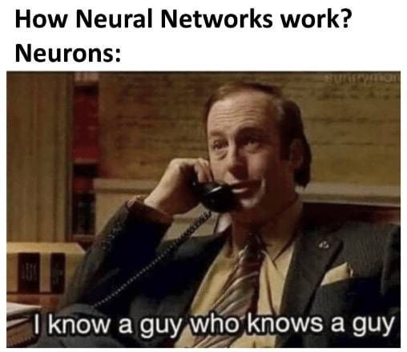
Notes:
Saul Goodman

Slide 11
Feedforward networks
This is a particular class called “feedforward” networks.
Cascade neurons together
[Slides: HKUST]
Notes:
Inside a neural network, you have a bunch of neurons connected to each other. Each neuron receives inputs and passes signals to the next neuron. On the first layer, you have the inputs to your neural network. These inputs get transformed through a series of weight multiplications and are passed on to individual nodes. We'll define what those nodes are, and each node processes the input signal and passes it on.

Slide 12
Feedforward networks
Inputs multiplied by initial set of weights
[Slide: HKUST]
Notes:
Visually, we start from the input, the values of which get transformed and passed on to the first layer of neurons. They process the input, pass it to the next layer, and so on, until the final layer makes a prediction.
Each node knows the next node it needs to pass the signal to. If you have questions or if anything is confusing, just ask.

Slide 13
Feedforward networks
Intermediate “predictions” computed at first hidden layer
[Slide: HKUST]
Notes:
Visually, we start from the input, the values of which get transformed and passed on to the first layer of neurons. They process the input, pass it to the next layer, and so on, until the final layer makes a prediction.
Each node knows the next node it needs to pass the signal to. If you have questions or if anything is confusing, just ask.

Slide 14
Feedforward networks
Intermediate predictions multiplied by second layer of weights
Predictions are fed forward through the network
[Slide: HKUST]
Notes:
Visually, we start from the input, the values of which get transformed and passed on to the first layer of neurons. They process the input, pass it to the next layer, and so on, until the final layer makes a prediction.
Each node knows the next node it needs to pass the signal to. If you have questions or if anything is confusing, just ask.

Slide 15
Feedforward networks
Compute second set of intermediate predictions
[Slide: HKUST]
Notes:
Visually, we start from the input, the values of which get transformed and passed on to the first layer of neurons. They process the input, pass it to the next layer, and so on, until the final layer makes a prediction.
Each node knows the next node it needs to pass the signal to. If you have questions or if anything is confusing, just ask.

Slide 16
Feedforward networks
Multiply by final set of weights
[Slide: HKUST]
Notes:
Visually, we start from the input, the values of which get transformed and passed on to the first layer of neurons. They process the input, pass it to the next layer, and so on, until the final layer makes a prediction.
Each node knows the next node it needs to pass the signal to. If you have questions or if anything is confusing, just ask.

Slide 17
Feedforward networks
Aggregate all the computations in the output
e.g. probability of a particular class
[Slide: HKUST]
Notes:
Visually, we start from the input, the values of which get transformed and passed on to the first layer of neurons. They process the input, pass it to the next layer, and so on, until the final layer makes a prediction.
Each node knows the next node it needs to pass the signal to. If you have questions or if anything is confusing, just ask.

Slide 18
Feedforward networks
All the intermediate parameters are ought to be learned.
Weights to learn!
Weights to learn!
Weights to learn!
[Slide: HKUST]
Notes:
We mentioned earlier that neural networks are general-purpose models that need to be trained for a specific objective. To do this, you need to tweak some parameters, specifically the weights in the architecture. These weights are the learnable parameters that we will adapt to the tasks we want to train the model for.

Slide 19
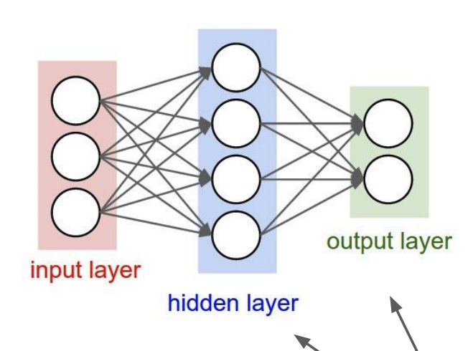
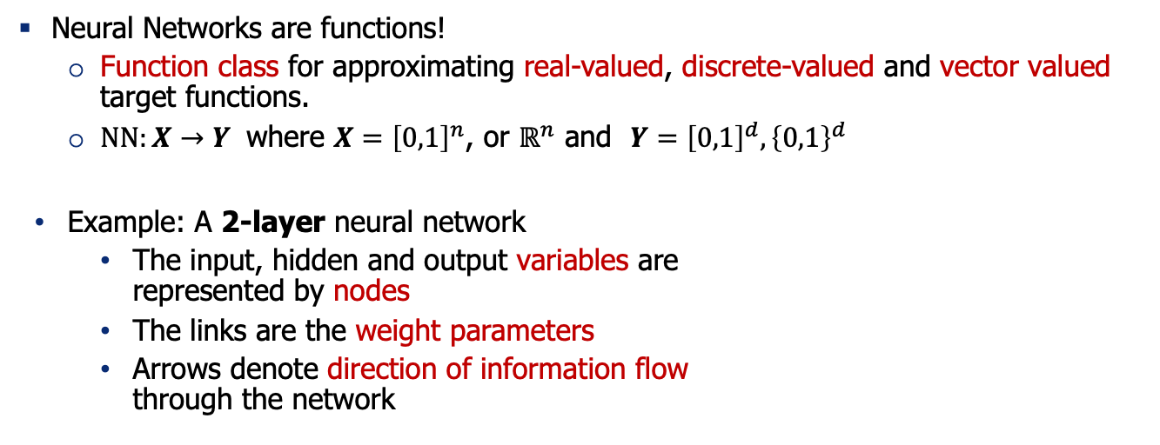
Feedforward Neural Network
Neural Networks are functions!
Function class for approximating real-valued, discrete-valued and vector valued target functions.
$NN:X→Y$ where $X={\left[0,1\right]}^{n}$, or $ℝ^{n}$ and $Y={\left[0,1\right]}^{d}, {\left\{0,1\right\}}^{d}$
Example: A 2-layer neural network
The input, hidden and output variables are represented by nodes
The links are the weight parameters
Arrows denote direction of information flow through the network
Notes:
Let's make this definition more formal by adding some math to define the function more concretely. A neural network is a function that maps an input from space X to an output in space Y. Your inputs can be discrete or continuous values from some input space, and your output can also be discrete or continuous in some high-dimensional space.
For example: this is a two-layer network with one hidden layer. Every layer between the input and output layers is called a hidden layer. You can have one hidden layer or many, depending on the complexity of the problem.

Slide 20
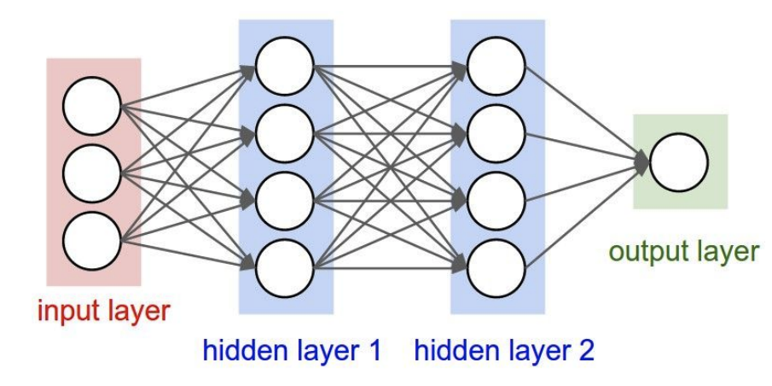
Neural Network: Making it bigger
Add more layers, or wider layers!
A 2-layer neural network A 3-layer neural network
Notes:
Similarly, this is a three-layer network.

Slide 21
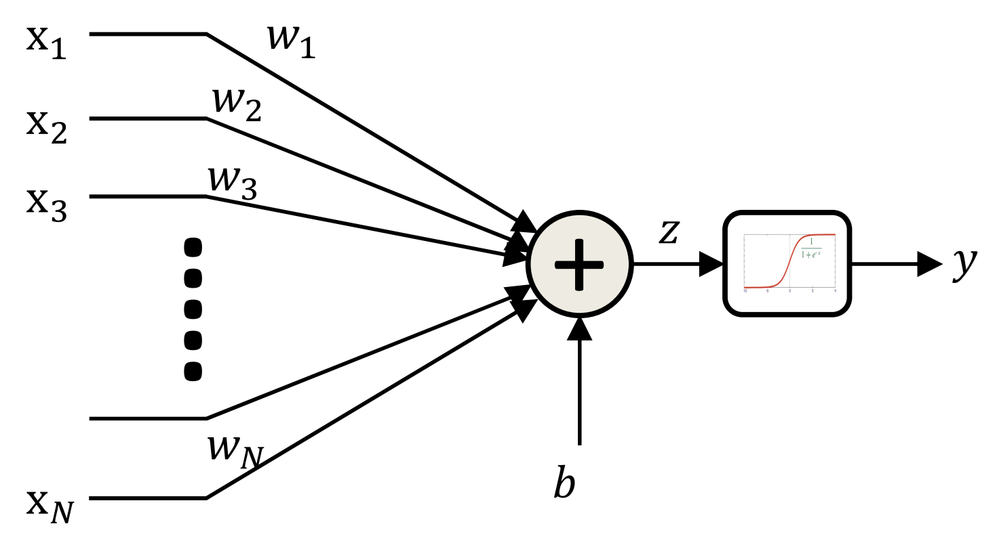
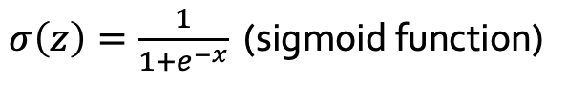
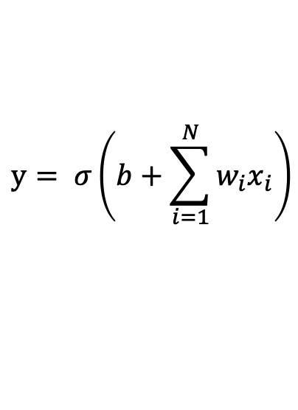
Feedforward Neural Network: The Neurons
A mathematical model of neuron is “perceptron”.
It consists of a non-linear function that “fires” if the affine (linear) function of inputs is above a threshold.
The bias is the negative of the threshold T in the previous slide
$$y= σ\left(b+\sum_{i=1}^{N}{w_{i}x_{i}}\right)$$
$σ\left(z\right)=\frac{1}{1+e^{−x}}$ (sigmoid function)
Notes:
We've talked about the overall architecture, but we haven't defined what's inside each of these circles. That's the element I defined as a neuron. A neuron receives a bunch of signals and emits signals to the next layer. Inside each circle, you receive an input, which is defined with more details.
These edges are weighted, and the weights are denoted as W1 to Wn for a sequence of inputs from X1 to Xn. This is an addition function that adds all these inputs.

Slide 22
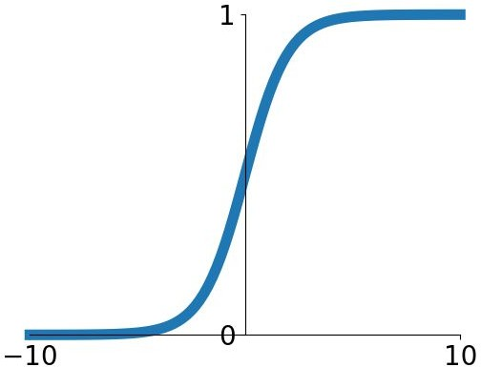
Feedforward Neural Network: The Neurons
Sigmoid is a “squashing” function.
It maps small inputs to zero.
It maps large inputs to one.
The bias is the negative of the threshold T in the previous slide
$$y= σ\left(b+\sum_{i=1}^{N}{w_{i}x_{i}}\right)$$
$σ\left(z\right)=\frac{1}{1+e^{−x}}$ (sigmoid function)
Notes:
Let me show this in mathematical form: you receive a sequence of x's as inputs, weight them based on the weights of these edges, sum them, and pass them to a nonlinearity function, shown here as sigma. This nonlinearity function applies a transformation to your input and passes that signal to the output, which is y, a single computational neuron.

Slide 23
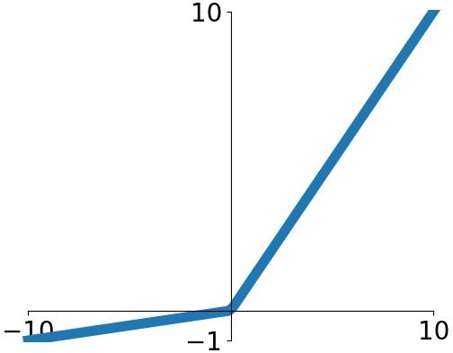
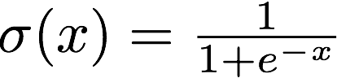
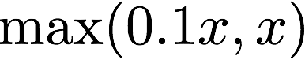
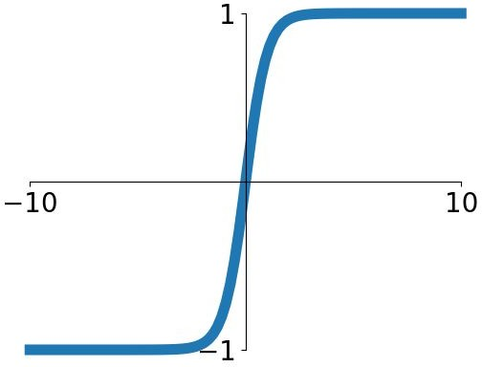
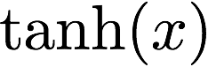
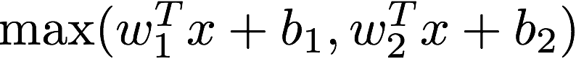
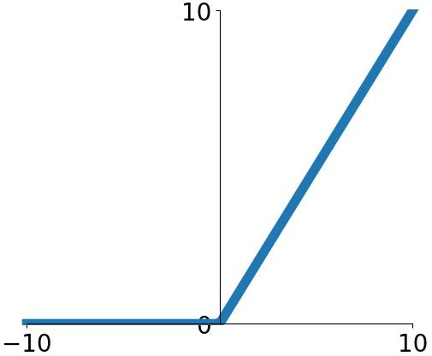
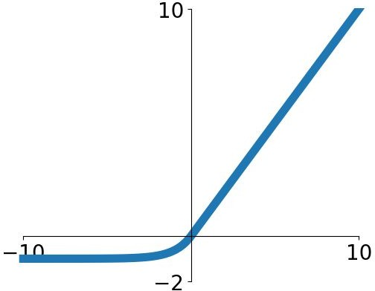
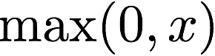
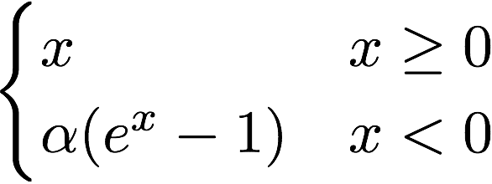
Other Activation Functions
Does not always have to be a squashing function
Sigmoid
tanh
Leaky ReLU
Maxout
ReLU
ELU
Fei-Fei Li & Justin Johnson & Serena Yeung Lecture 6 - April 19, 2018
We will talk about their pro/cons later!
Notes:
One thing to be clear about is that there are a variety of activation functions or nonlinearities. This is just one particular choice. There are many different choices, and we'll talk about their pros and cons later. For now, we'll table that conversation.

Slide 24
Terminology: Multi-Layer Perceptron (MLP)
Multi-layer Perceptron (MLP):
A feedforward network with perceptron as its nodes.
A feedforward network does not have to be an MLP.
But people sometimes use the names interchangeably! 🤷
The original MLP [McCulloch–Pitts] was based on “threshold” activation.
Notes:
By putting all these standardized neurons together, we get an architecture commonly referred to as a multi-layer perceptron. This definition of a neuron is commonly referred to as a perceptron, and when you stack them, you get a multi-layer perceptron, also known as a feed-forward network because each layer processes some input and feeds it to the next layer.

Slide 25
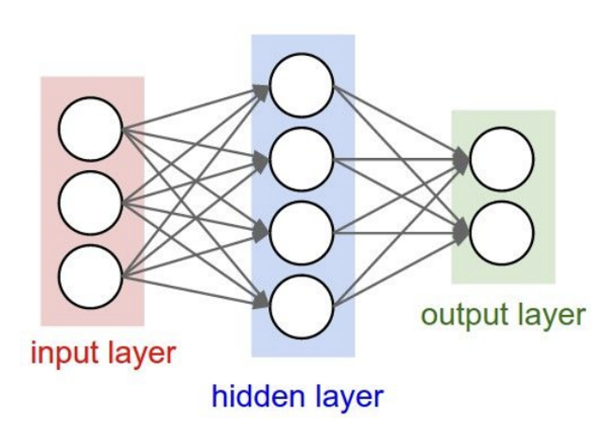
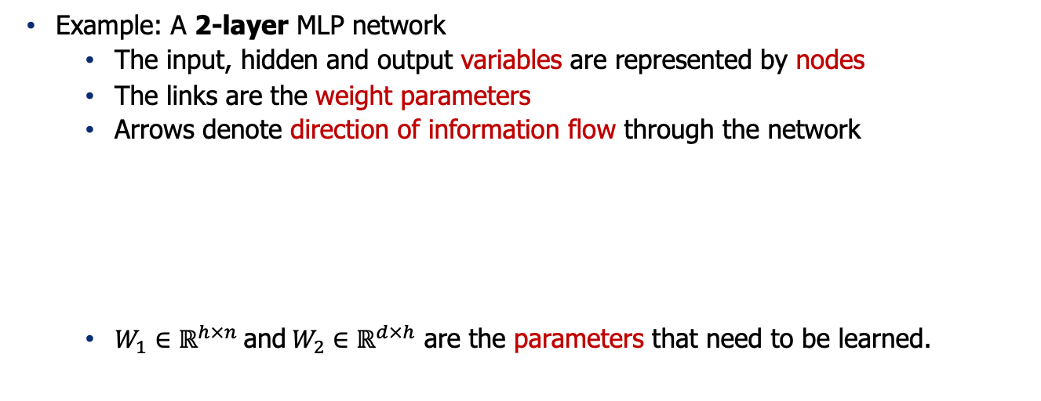
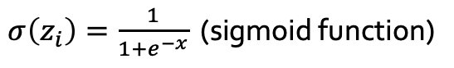
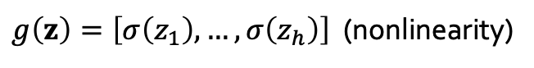
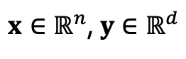
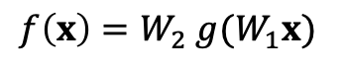
Formally Defining an MLP
Example: A 2-layer MLP network
The input, hidden and output variables are represented by nodes
The links are the weight parameters
Arrows denote direction of information flow through the network
$W_{1}∈ℝ^{h×n} \text{and} W_{2}∈ℝ^{d×h}$ are the parameters that need to be learned.
$$f\left(x\right)=W_{2} g(W_{1}x)$$
$x∈ℝ^{n}$, $y∈ℝ^{d}$
$g\left(z\right)=\left[σ\left(z_{1}\right), …, σ\left(z_{h}\right)\right]$ (nonlinearity)
$σ\left(z_{i}\right)=\frac{1}{1+e^{−x}}$ (sigmoid function)
Notes:
Now, let's define a neural network more formally. Let's say we have this two-layer network with a bunch of inputs, one hidden layer, and one output. You can define it formally like this: you have an x that you multiply by a matrix W1, then give that to a linear function defined as g, which is a vector of sigmoid functions. You then give the result to another matrix multiplication, which represents the weights of the second layer, and the result is the output. I've defined this network in mathematical form.

Slide 26
Quiz Time (1)
What is needed to fully specify a neural network?
Architecture (which input goes through what function etc.)
Parameters of the function (the weights)
Both
Notes:
Let's try a quiz to ensure everyone is on the same page.
What is needed to fully specify a neural network?
Is it the architecture, the parameters of the functions, or both?
What do you think?
Indeed, The architecture and parameters are both needed. The architecture defines which variables connect to what, and the parameters are the weights needed to specify the connections. So, we need both the architecture and the parameters.

Slide 27
Quiz Time (2)
Which of the followings has more parameters?
Notes:
Quiz two: Which of these architectures has more parameters?
I’ll let you think about it in your own.
If not clear, review the previous content.

Slide 28
Quiz Time (3)
Given an input to these models, which of them take longer to compute an output?
Notes:
Quiz three: Given an input to these models, which of them takes longer to compute the output?
The one on the right has more layers, so it will take longer due to the sequential nature of computation in feed-forward networks.
Each layer must be computed before the next, so more layers mean a longer computation time.

Slide 29
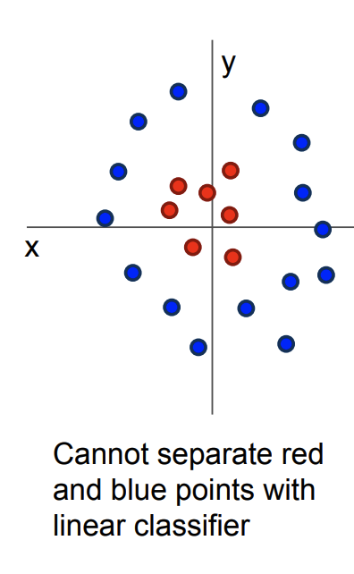

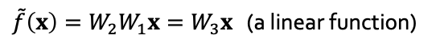
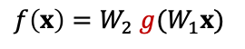
Why Add Non-linearity?
Without non-linearity, the overall model amounts to a linear model.
A linear function cannot approximate complex tasks.
Non-linearity adds capacity to the model to approximate any continuous function to arbitrary accuracy given sufficiently many hidden units.
See “universal approximation theorem”
$$f\left(x\right)=W_{2} g(W_{1}x)$$
$\tilde{f}\left(x\right)=W_{2}W_{1}x=W_{3}x$ (a linear function)
drop $g$
Notes:
Another question: Why do we need the nonlinearity function? Why can't we just get rid of it?
Without nonlinearity, the network is just a linear function, and we wouldn't get the power of nonlinearity to slice up space.
Nonlinearity allows for more complex representations, which are necessary for tasks that aren't linearly separable.

Slide 30
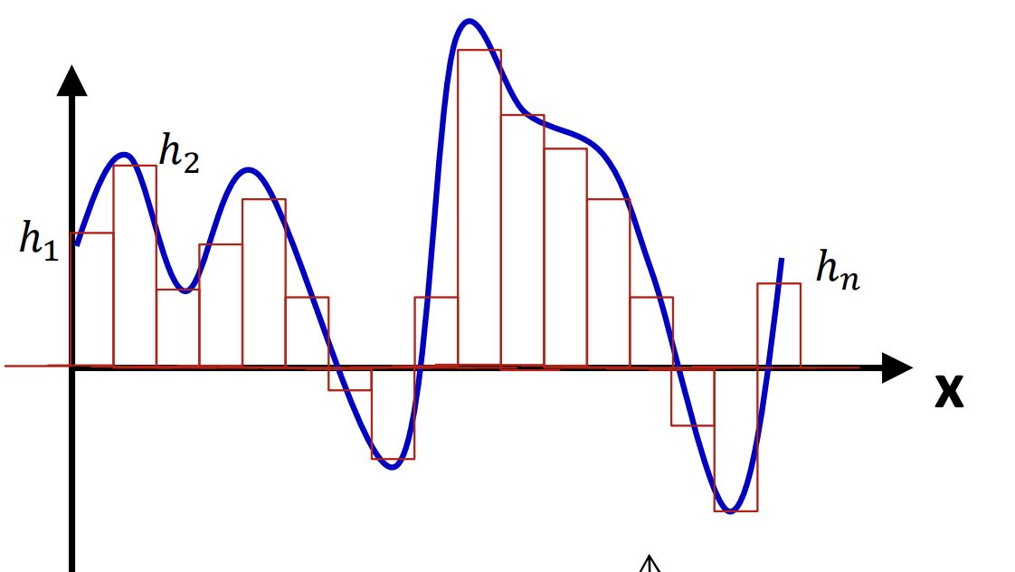
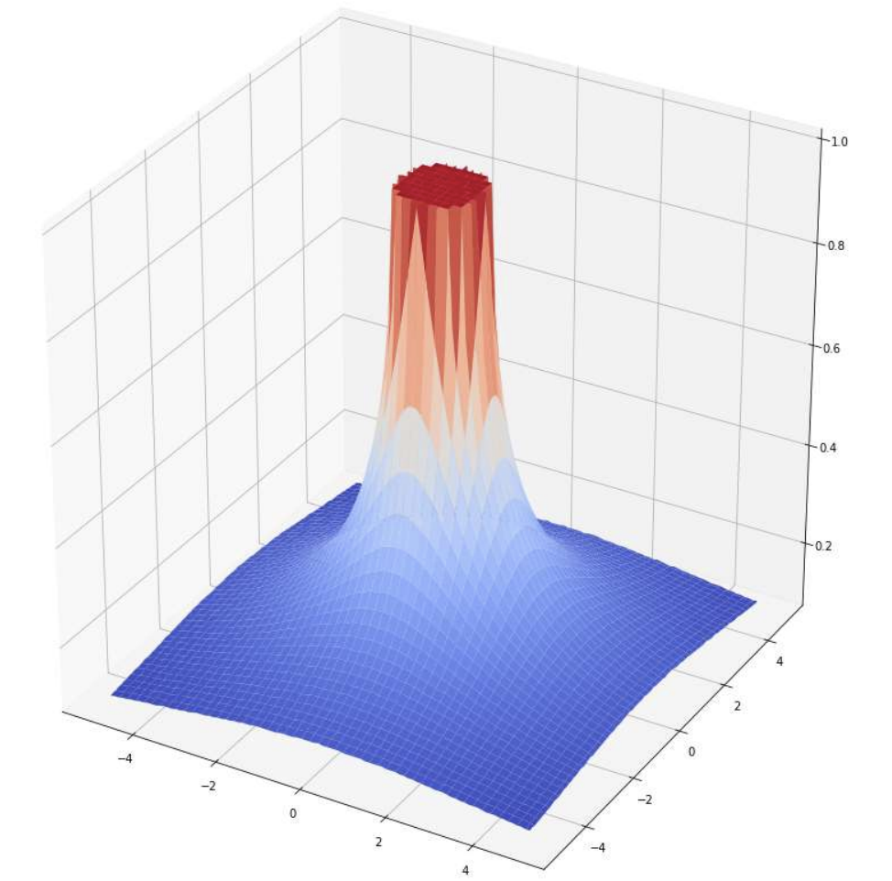
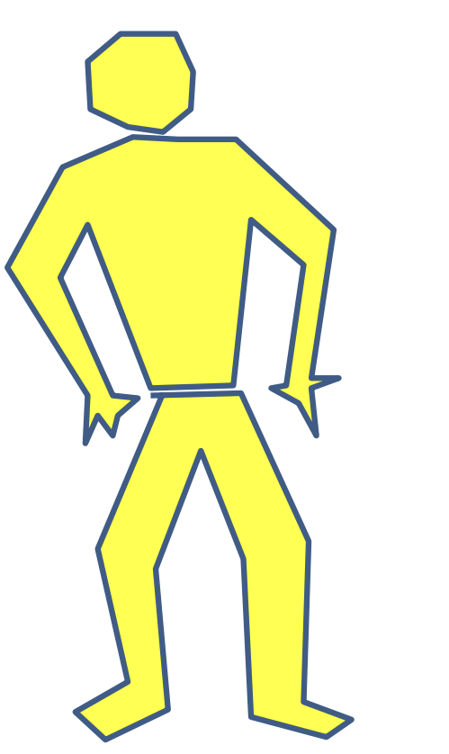
Universal Approximation
An MLP can represent any function, with enough expressivity.
Maiorov & Pinkus. Lower bounds for approximation by MLP neural networks, 1999.
Notes:
There are results in theoretical machine learning that show neural networks are universal approximators. This means that any function you have in mind can be represented by a neural network with enough capacity. This capacity could be nonlinearity, the size of the network, or other factors. This is called the Universal Approximation Theorem.

Slide 31
Quiz Time
What makes neural networks expressive functions?
Activations (non-linearities)
Depth (number of hidden layers)
Width (number of variables in each hidden layer)
All the above
Notes:
Quiz: What makes neural networks expressive functions? Is it their activations, depth, width, or all of the above?
All of the above. Activations, depth, and width all contribute to the expressiveness of neural networks.

Slide 32
Demo time!
Link: https://playground.tensorflow.org/
Notes:
Let's verify this with a demo. We have a simple example with clusters of lines.

Slide 33
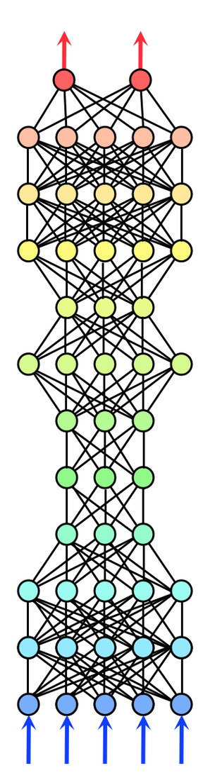
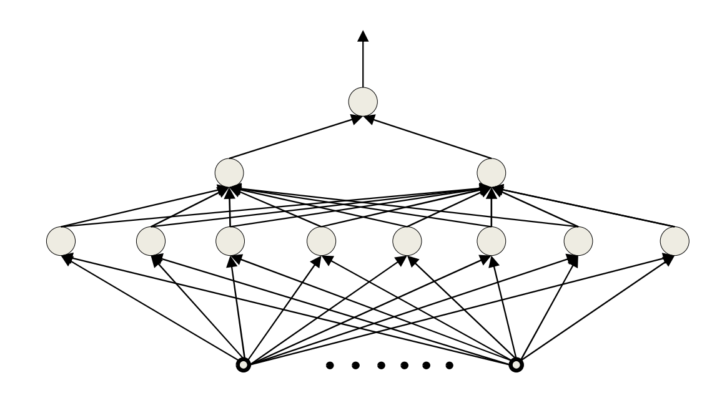
What is a good architecture? Depth vs. Width
Architectural parameters of a neural network affect its capacity to learn.
Deep vs. wide
Notes:
Alright, moving on. Now, here's a question for you: earlier we discussed whether it's more important to add layers or width to your architecture. Which one should you prioritize? This is surprisingly a non-trivial question to answer. I can tell you that there are theoretical understandings regarding the impact of the depth of a neural network versus its width.

Slide 34
Depth vs Width on Boolean functions
An MLP is a universal Boolean function.
A shallow (single hidden layer) is a universal Boolean machine
But it may require an exponentially large number of units.
Deeper networks may require far fewer neurons than shallower networks to express the same function
Notes:
In the context of Boolean functions, let's say you want to train a neural network to simulate a Boolean function. A Boolean function is essentially a composition of ANDs and ORs on binary input.
Analysis on ”circuits” provide intuitions about the power of depth vs. width in neural networks.
Circuit: functions constructed with logical gates (AND, OR, XOR, …).

Slide 35
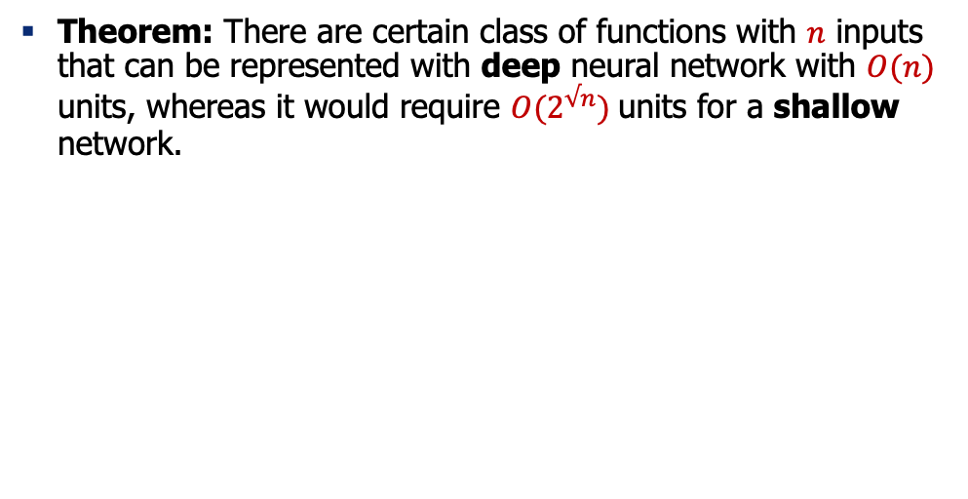
Depth vs Width on Boolean functions
Theorem: There are certain class of functions with $n$ inputs that can be represented with deep neural network with $O(n)$ units, whereas it would require $O(2^{√n})$units for a shallow network.
Hastad, Almost optimal lower bounds for small depth circuits, 1986.
Delalleau & Bengio. Shallow vs. deep sum-product networks, 2011.
Notes:
Now, if we want to train a neural network that approximates an arbitrary Boolean function, we know—there are proofs for this—that even a shallow neural network with just a few layers is a universal approximator of Boolean functions.
However, the width of this neural network might be extremely large. Deeper neural networks can also be universal approximators of Boolean functions, but they require far fewer neurons to achieve this. To make this point more formal, there's a theorem that states there are classes of functions with n inputs that can be represented with deep neural networks with a number of neurons that is in the same order as a linear function of your inputs. However, if you were to build a shallow network, the width of your architecture would be exponentially larger. That's the trade-off between depth and width. You might get a much more compact network by adding more depth, and that's where the term "deep learning" comes from. The idea is that if you make your architecture deep enough, it will give you really good expressive functions that can solve a variety of problems.

Slide 36
Summary
An MLP is a universal function
But can represent a given function only if
It is sufficiently wide
It is sufficiently deep
Depth can be traded off for (sometimes) exponential growth of the width of the network
Optimal width and depth depend on the complexity of the problem.
Next: A bit of history.
Notes:
To summarize, we talked about multi-layer perceptrons being universal functions that can represent many things. Whether they can represent many things or not depends on whether you give them enough capacity, meaning sufficient width, sufficient depth, and also nonlinearities that add more expressivity to your architecture. The optimal width and depth depend on the complexity of the problem; they're empirical questions that we need to answer based on our problem.
Next, we're going to talk about a bit of history behind neural networks, but before that, take a break, drink some water, and say hello to your neighbor.

Slide 37
Neural Nets: Origin and History
Notes:
Now, let's talk about the origin and history of neural networks.

Slide 38


Artificial Neurons: An Inspiration from Nature
A single node in your neural network
Accept information from multiple inputs
Transmit information to other neurons
A neuron’s function is inspired by its biological counterpart:
Apply some function on inputs signals
If output of function over threshold, neuron “fires”
Notes:
The first thing to mention is the inspiration from nature. As you might have guessed or heard, neural networks are inspired by what's happening in nature, specifically in the human brain. All the computational neurons we saw earlier, the linear function of input, and the activation function are really simulations of what's happening within your brain's neurons. Inside each neuron, you have these sensors, called dendrites in neuroscience, that collect signals from neighboring neurons. They're equivalent to the linear lines you have. These sensors collect information and bring the signal to the cell body inside your neuron. The cell body is essentially the summation function that gathers the signals and decides how to propagate them further to other neurons. The axon takes the signal from here, and if it's strong enough, it passes it on to the branches of your neuron. This firing is equivalent to the nonlinearity function. If your signal is strong enough, it results in firing or activation in the output of your artificial neuron.
From Wikipedia: At the majority of synapses, signals are sent from the axon of one neuron to a dendrite of another... All neurons are electrically excitable, maintaining voltage gradients across their membranes… If the voltage changes by a large enough amount, an all-or-none electrochemical pulse called an action potential is generated, which travels rapidly along the cell's axon, and activates synaptic connections with other cells when it arrives.
The dendrite of the neuron receives signals (information) from other neurons. The body of the neuron processes this information and if the accumulated signal is strong enough (exceeds a certain threshold), it sends it further through a long 'cable' called an axon. The axon terminus connects with the dendrites of other neurons through synapses. The strength of the connections between the neurons, i.e., the synapses, change as we learn - this process is known as synaptic plasticity.
The strength of the connections between the artificial neurons, similar to synapses in biological neurons, is represented by weights, which are adjusted during the training process, mirroring the process of synaptic plasticity in the human brain.
So in the analogy, dendrites are like the input values in an artificial neuron, the neuron body is like the processing stage (sum and non-linear function) in the artificial neuron, the axon is like the output of the artificial neuron, and synapses are analogous to the weights assigned to the inputs in artificial neural networks.

Slide 39
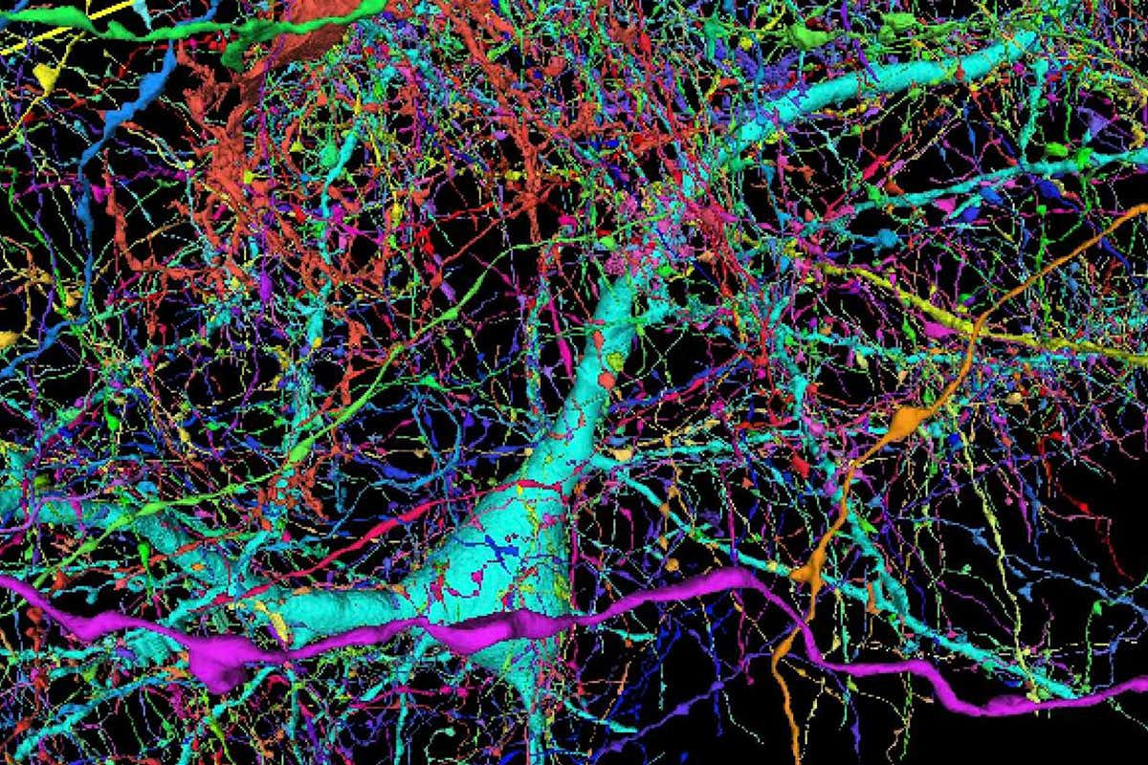
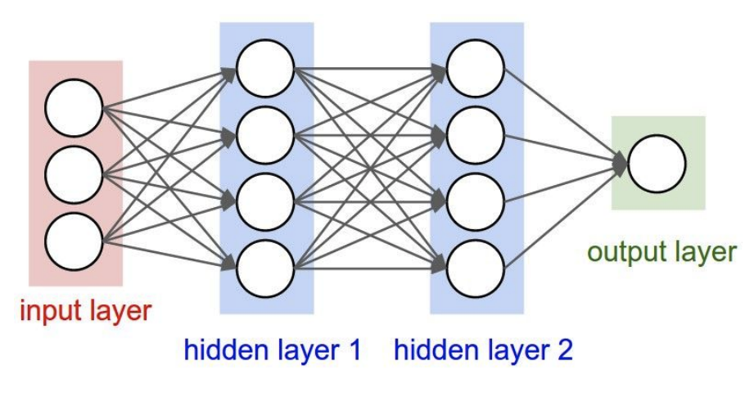
Artificial Neurons: Not Quite Analogous to Nature
Neurons in an artificial neural network:
organized based on a highly regular structure for computational efficiency
Biological neurons: complex connectivity
Source: Google Brain Map
Notes:
However, I want to caution you not to take these analogies too literally because the nature of the human brain is very different from artificial neurons. The human brain is highly complex with dense connections, unlike the organized and sequential nature of artificial neurons. They're quite different, like apples and oranges. Maybe in the future, they'll get closer, but for now, we have this loose analogy between the two.
Be careful with analogies:
Many different types
Dendrites can perform complex non-linear computations
Synapses are not a single weight but a complex nonlinear dynamical system
Abstracting a neuron by “firing rate” isn’t enough; temporal sequences of activations matter too (spiking neural networks)

Slide 40
Very Brief History of Neural Networks
Single-layer neural networks (1943-1969)
Symbolic AI & knowledge engineering (1970-1985)
Multi-layer NNs and symbolic learning (1985-1995)
Shallow statistical learning/probabilistic models (1995-2010)
Deep networks and self-supervised learning (2010-?)
Notes:
Now, let's go into the history and see how we got to this point.

Slide 41
Very Brief History of Neural Networks
Single-layer neural networks (1943-1969)
Symbolic AI & knowledge engineering (1970-1985)
Multi-layer NNs and symbolic learning (1985-1995)
Shallow statistical learning/probabilistic models (1995-2010)
Deep networks and self-supervised learning (2010-?)

Slide 42
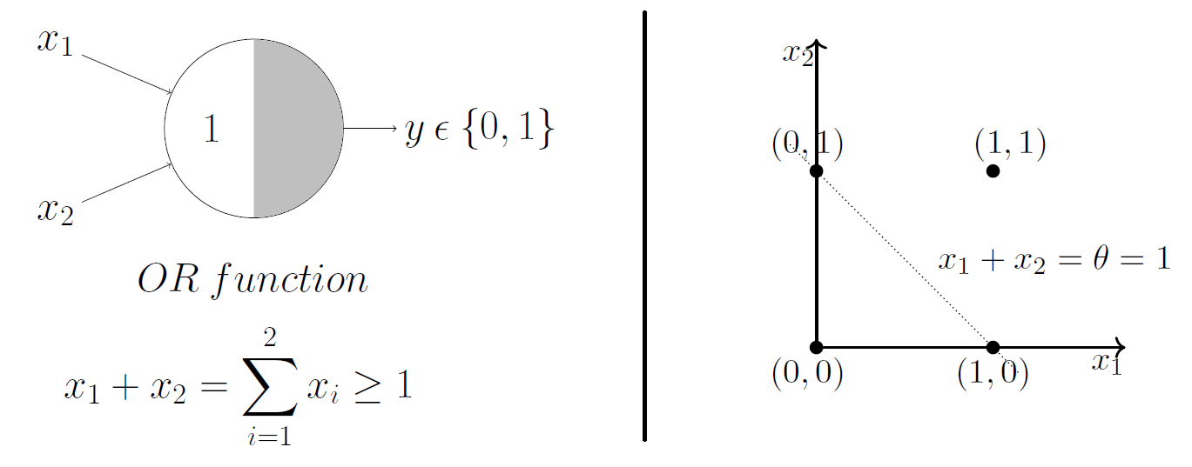
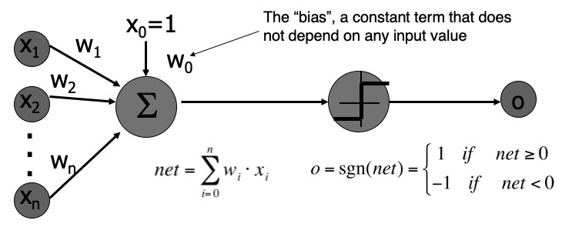
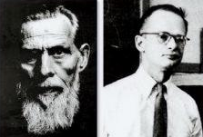
A Neuron as a Mathematical Model of Computation
McCulloch and Pitts (1943) showed how linear threshold units can be used to compute logical functions
An alternative model of computation (comparable to “Turing Machine”)
Notice the step function (threshold)! Early models didn’t need to be differentiable.
[A Logical Calculus of Ideas Immanent in Nervous Activity, McCulloch and Pitts 1943]
Notes:
We talked about history a bit in the first class, but I want to add more details.
The original works that inspired later developments were by McCulloch and Pitts, who created a simple formula for a single neuron called a linear threshold unit.
Notice that the nonlinearity function here is not differentiable; it's just a step function. Back then, they didn't care about differentiability; they just wanted to study its expressivity. It was essentially an average function followed by a step function, and they showed it could express many logical operators like the OR function. They thought of it as another framework for thinking about computation, similar to a Turing machine.
Walter Pitts, one of the scientists, didn't have much academic background. He was interested in human cognition and lived in libraries, homeless for a while. When he met McCulloch, they started working together, wrote a paper, and Pitts eventually got job offers. It's an inspirational story, especially if you're having a difficult day.

Slide 43
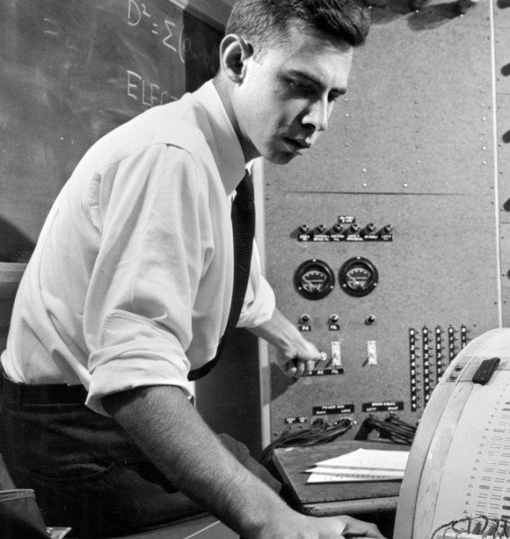
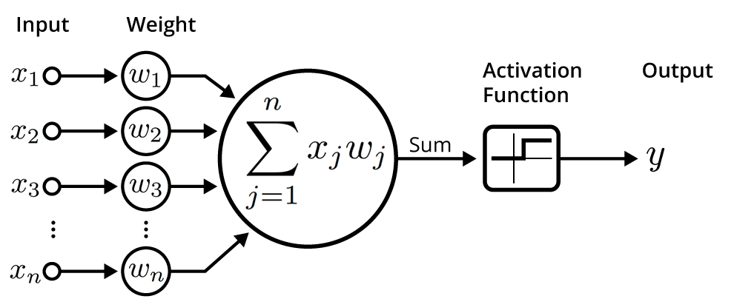
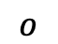
Perceptron Learning Rule — Imitating Nature’s Learning Process
Rosenblatt (1959) developed the Perceptron algorithm —
An iterative algorithm for learning the weights of a linear threshold unit.
A single neuron with a fixed input, it can incrementally change weights and learn to produce a fixed output using the Perceptron learning rule.
Update each weights by:
$$o$$
t: the target value
[The perceptron: a probabilistic model for information storage and organization in the brain, Rosenblatt 1959]
Notes:
Rosenblatt took their model, the linear threshold unit, and defined a learning framework for adjusting the weights of these inputs so that this simple framework could learn a function. The learning rule Rosenblatt came up with was an update rule. At every iteration, you take the existing weight corresponding to input xi, add a term, and get a new term for that weight. This term is the difference between the target value and the current prediction, multiplied by a constant and the input value. This learning rule is similar to gradient descent, although Rosenblatt developed it independently.

Slide 44
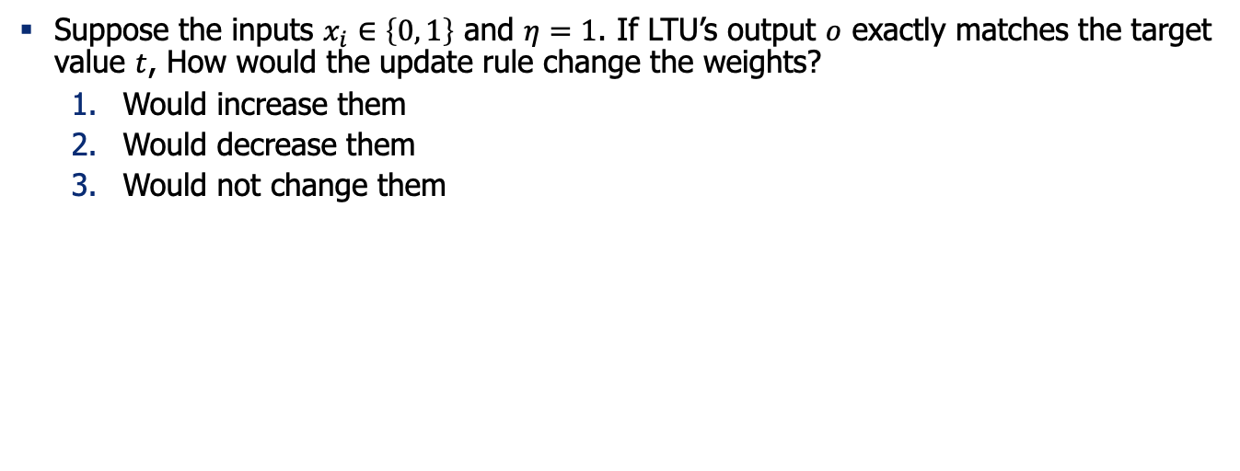
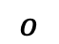
Quiz (1): Understanding Perceptron Update Rule
Suppose the inputs $x_{i}∈\left\{0, 1\right\}$ and $η=1$. If LTU’s output $o$ exactly matches the target value $t$, How would the update rule change the weights?
Would increase them
Would decrease them
Would not change them
$$o$$
Notes:
Let's test your understanding of this formula. Suppose our neuron produces an output that matches the target value. If we run this update rule, how will it change the weights? It won't change because the output matches the target, making the update term zero. Now, if the output is smaller than the target, the update rule will increase the weights, making the new output larger.

Slide 45
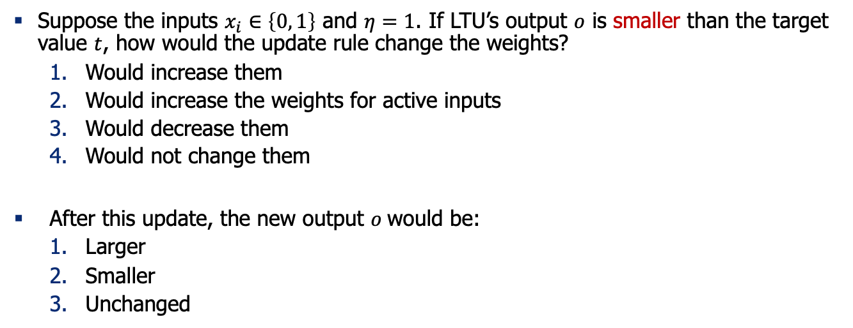
Quiz (2): Understanding Perceptron Update Rule
Suppose the inputs $x_{i}∈\left\{0, 1\right\}$ and $η=1$. If LTU’s output $o$ is smaller than the target value $t$, how would the update rule change the weights?
Would increase them
Would increase the weights for active inputs
Would decrease them
Would not change them
After this update, the new output $o$would be:
Larger
Smaller
Unchanged
$$o$$

Slide 46
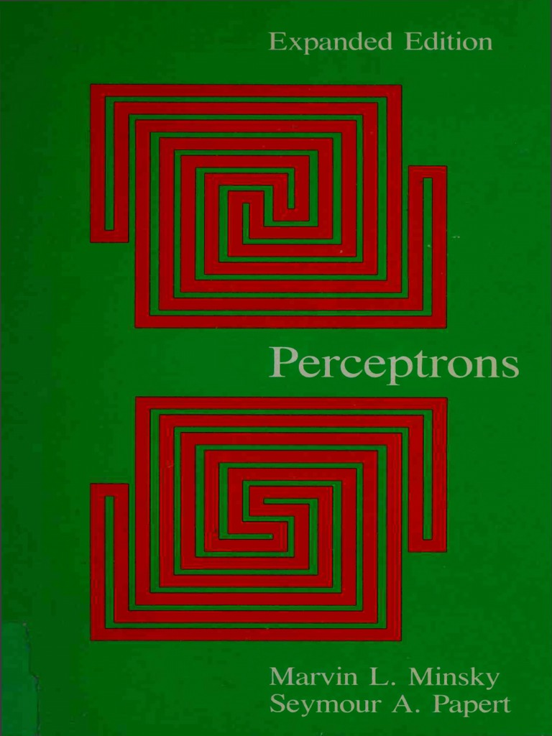
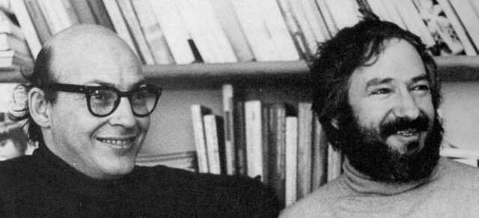
Perceptron: Demise
“Perceptrons” (1969) by Minsky and Papert illuminated few limitations of the perceptron.
It showed that:
Shallow (2-layer) networks are unable to learn or represent many classification functions (e.g. XOR)
Only the linearly separable functions are learnable.
Also, there was an understanding that deeper networks were infeasible to train.
Result: research on NNs dissipated during the 70’s and early 80’s!
[slide: Ray Mooney]
Notes:
Rosenblatt's update rule for the perceptron generated excitement because it provided a computational model of human neurons and a formula for training them. However, Minsky and Papert wrote a book highlighting the limitations of perceptrons, such as their inability to learn certain functions with shallow architectures. This led to disappointment in neural networks, contributing to an "AI winter" where interest in neural networks waned for about 20 years.

Slide 47
Very Brief History of Neural Networks
Single-layer neural networks (1943-1969)
Symbolic AI & knowledge engineering (1970-1985)
Multi-layer NNs and symbolic learning (1985-1995)
Shallow statistical learning/probabilistic models (1995-2010)
Deep networks and self-supervised learning (2010-?)

Slide 48
Very Brief History of Neural Networks
Single-layer neural networks (1943-1969)
Symbolic AI & knowledge engineering (1970-1985)
Multi-layer NNs and symbolic learning (1985-1995)
Shallow statistical learning/probabilistic models (1995-2010)
Deep networks and self-supervised learning (2010-?)
Notes:
In the next stage, people shifted to different AI approaches.

Slide 49
Neural Networks Resurgence (1986)
Interest in NNs revived in the mid 1980’s due to the rise of “connectionism.”
Backpropagation algorithm was [re-]introduced for training three-layer NN’s.
Generalized the iterative “hill climbing” method to approximate networks with multiple layers, but no convergence guarantees.
what was possible
to train in 1970’s
what became possible to train via BP in 1980’s
[Learning representations by back-propagating errors, Rumelhart, Hinton & Williams 1986; for a broader context, see: http://people.idsia.ch/~juergen/who-invented-backpropagation.html]
Notes:
The third stage was sparked by findings about more efficient algorithms for training deeper neural networks, like backpropagation. This algorithm, a sophisticated form of gradient descent, made training deeper architectures more feasible.

Slide 50
Second NN Demise (1995-2010)
Generic backpropagation did not generalize that well to training deeper networks.
Overfitting / underfitting remained an issue.
Computers were still quite slow
Little theoretical justification for underlying methods.
Machine learning research moved to graphical/probabilistic models and kernel methods.
[slide: Ray Mooney]
Notes:
However, challenges like computational expense and overfitting persisted, leading to another decline in neural network use.

Slide 51
Very Brief History of Neural Networks
Single-layer neural networks (1943-1969)
Symbolic AI & knowledge engineering (1970-1985)
Multi-layer NNs and symbolic learning (1985-1995)
Shallow statistical learning/probabilistic models (1995-2010)
Deep networks and self-supervised learning (2010-?)

Slide 52
Very Brief History of Neural Networks
Single-layer neural networks (1943-1969)
Symbolic AI & knowledge engineering (1970-1985)
Multi-layer NNs and symbolic learning (1985-1995)
Shallow statistical learning/probabilistic models (1995-2010)
Deep networks and self-supervised learning (2010-?)

Slide 53
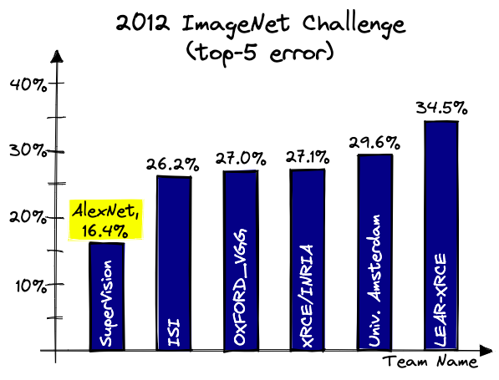

Deep Learning Revolution (2010…)
Various successes with training deep neural works.
Convolutional neural nets (CNNs) for vision — 2012 AlexNet showed 16% error reduction on ImageNet benchmark.
Rise of deep reinforcement learning for games—AlphaGo beat human players.
Notes:
Eventually, with faster computers and more data, interest in neural networks resurged. A key moment was the introduction of AlexNet, a neural network that significantly reduced error rates in image classification competitions. This success, along with others like AlphaGo, marked the third era of neural networks. The number of machine learning publications has since increased rapidly, driven by algorithmic improvements, better computational architectures, and more data.

Slide 54
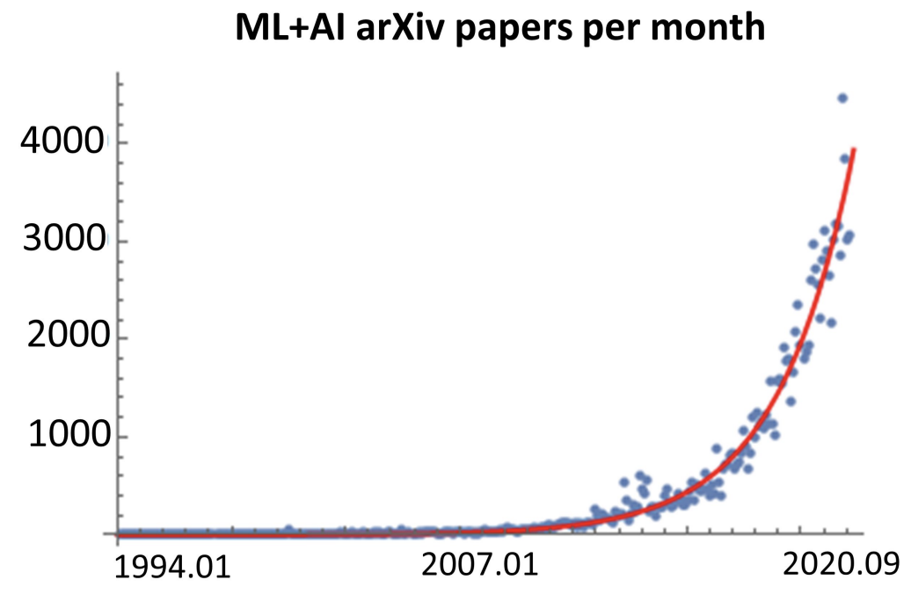
Deep Learning Revolution (2010…)
Various successes with training deep neural works.
Convolutional neural nets (CNNs) for vision — 2012 AlexNet showed 16% error reduction on ImageNet benchmark.
Rise of deep reinforcement learning for games—AlphaGo beat human players.
arXiv papers per month
Figure credit:
https://twitter.com/MarioKrenn6240/status/1314622995139264517

Slide 55
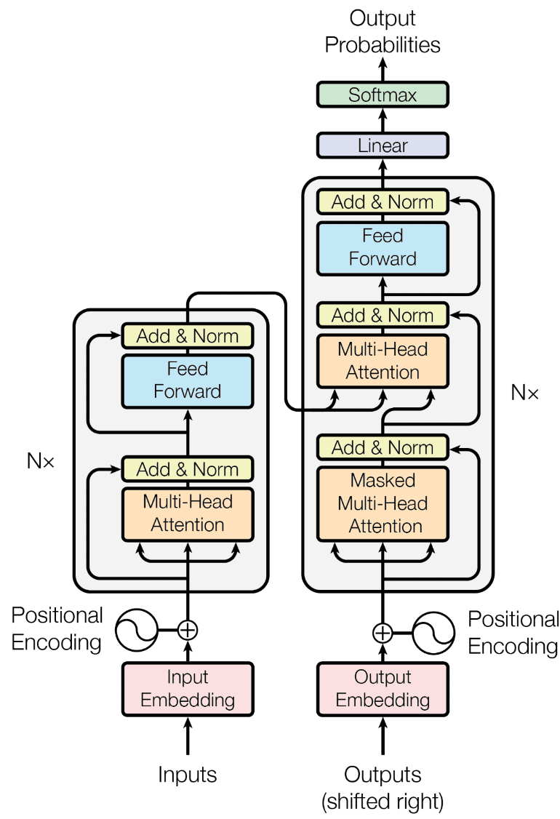


Deep Learning Revolution (2010…)
The success continued enabled by 3 forces:
Availability of massive [unlabeled] data — the data on Internet.
Faster computing technologies — specialized hardware (e.g., GPUs)
Algorithmic innovations — architectures, optimization, etc.

Slide 56
Very Brief History of Neural Networks
Single-layer neural networks (1943-1969)
Symbolic AI & knowledge engineering (1970-1985)
Multi-layer NNs and symbolic learning (1985-1995)
Shallow statistical learning/probabilistic models (1995-2010)
Deep networks and self-supervised learning (2010-?)

Slide 57

https://en.wikipedia.org/wiki/Big_Bounce
Notes:
The history of AI very much resembles a model of universe in cosmology, in which it goes through periods of expansion and contraction
The first one ….
The second one …
Now it seems like we are at a major expansion
If history is any guide, we will inevitably go though another round of contraction in future, but the technology will come out stronger and better at the end of it.

Slide 58

How it started How it’s going
[slide: Ray Mooney]
Notes:
We started with McCulloch and Pitts' model and have now reached deep architectures with many parameters, managed by engineers working with large GPU clusters.

Slide 59
Summary
Neural networks have been long in the making since 1950s.
It’s a remarkable journey of science with many ups and downs.
Next: How do you train NNs? We will start with some algebra refreshers.
Notes:
To summarize, neural networks have been a long time in the making, with a remarkable journey of ups and downs. Next, we'll focus on how to train neural networks, starting with an algebra refresher. If you're in favor of the refresher, raise your hand. We'll continue for about seven minutes to cover the fundamentals before diving into training.

Slide 60
Background for Training NNs The Refreshers🍹

Slide 61

Machine Learning Problems
Training data: Given a set of inputs and output labels:
Inputs: $X=\left(x_{1},…,x_{n}\right)$
Outputs: $Y=\left(y_{1},…,y_{n}\right)$
Goal: Find a function $f(x;θ)$ with parameters $θ$ that maps inputs in $X$ to output to $Y$
Empirical risk: measure the quality of the predictions with a loss function:
$$J\left(θ\right)=\frac{1}{n}\sum_{i=1}^{n}{ℓ(f\left(x_{i};θ\right), y_{i})}$$
Notes:
The setup for statistical learning involves training data with inputs and corresponding output labels. The goal is to train a function, represented by parameters, to approximate the mapping from inputs to outputs. You define a loss function over your training data to quantify the gap between predictions and gold labels, aiming to minimize this loss.

Slide 62


A Special Case: Linear Regression
Training data: Given a set of inputs and output labels:
Inputs: $X=\left(x_{1},…,x_{n}\right)$
Outputs: $Y=\left(y_{1},…,y_{n}\right)$
Goal: Find a linear function $f\left(x;θ\right)=θ.x$ that is best predictive of observations
Empirical risk: measure the quality of the predictions with a loss function:
$$J\left(θ\right)=\frac{1}{n}\sum_{i=1}^{n}{ℓ(θ.x_{i}, y_{i})}$$
What are good choices for loss function?
Notes:
An analogy is linear regression, where you have noisy samples from a line function. The loss function quantifies the distance between the predicted and actual outputs. The choice of loss function is important. A reasonable loss function should have a higher value when predictions are far from the target. Common loss functions include squared loss and absolute loss, but our focus is on cross-entropy loss.

Slide 63

Quiz: Loss functions
Remember the objective function of our learning problem:
$$J\left(θ\right)=\frac{1}{n}\sum_{i=1}^{n}{ℓ(f\left(x_{i};θ\right), y_{i})}$$
Which of the followings is a more reasonable loss function $ℓ\left(z, w\right)$?
If $z$and $w$are far apart, the loss value should be higher
If $z$and $w$are far apart, the loss value should be lower
Neither

Slide 64



Loss Functions
The choice of loss function depends on the problem
$$ℓ\left(y, \hat{y}\right)={\left(y−\hat{y}\right)}^{2}$$
$$ℓ\left(y, \hat{y}\right)=|y−\hat{y}|$$

Slide 65



Quiz: MSE vs. MAE loss
MSE: $ℓ\left(y, \hat{y}\right)={\left(y−\hat{y}\right)}^{2}$
Remember MSE and MAE loss:
Which visualization corresponds to which loss?
Which loss is more sensitive to outlier data (noisy outputs)?
Which loss is more difficult to compute gradients for?
MAE: $ℓ\left(y, \hat{y}\right)=|y−\hat{y}|$

Slide 66

Loss Functions
The choice of loss function depends on the problem
$$ℓ\left(y, \hat{y}\right)={\left(y−\hat{y}\right)}^{2}$$
$$ℓ\left(y, \hat{y}\right)=|y−\hat{y}|$$
$$ℓ\left(y, \hat{y}\right)=−\sum_{j}^{n}{y_{j}log⁡(\hat{y_{j}})}$$

Slide 67


Loss Functions: Cross-Entropy
$$ℓ\left(y, \hat{y}\right)=−\sum_{j}^{n}{y_{j}log⁡(\hat{y_{j}})}$$
A binary classification example: Without loss of generality:
Gold labels: $y=[1, 0]$ (i.e., first class is correct)
Predictions: $\hat{y}=\left[p, 1−p\right]$
CE loss: $ℓ\left(y, \hat{y}\right)=−1×\log{p}−0×\log\left(1−p\right)=−\log{p}$
Question for you:
If the model prediction is completely accurate, what is the loss?
If the model prediction is completely off, what is the loss?
Summation over the dimensions of y
Notes:
Cross-entropy loss is computed over the dimensions of your prediction. For binary prediction, the goal label is either one class or the other. The model makes a probabilistic prediction, and cross-entropy quantifies the loss based on the accuracy of this prediction. If the model is accurate, the loss is zero; if inaccurate, the loss is high.

Slide 68

Machine Learning Problems
Training data: Given a set of inputs and output labels:
Inputs: $X=\left(x_{1},…,x_{n}\right)$
Outputs: $Y=\left(y_{1},…,y_{n}\right)$
Goal: Find a function $f(x;θ)$ with parameters $θ$ that maps inputs in $X$ to output to $Y$
Empirical risk: measure the quality of the predictions with a loss function:
$$J\left(θ\right)=\frac{1}{n}\sum_{i=1}^{n}{ℓ(f\left(x_{i};θ\right), y_{i})}$$
Machine learning as optimization:
$\underset{θ}{argmin}{J\left(θ\right)}$
How do you solve this optimization?

Slide 69


Gradient Descent
We have a cost function $J\left(θ\right)$we want to minimize
We can use Gradient Descent algorithm!
Idea: for current value of $θ$, calculate gradient of $J\left(θ\right)$, then take small step in direction of negative gradient. Repeat.
Note: Our objectives may not be convex like this. But life turns out to be okay!

Slide 70


Gradient Descent (1): Intuition
Imagine you’re blindfolded
Need to walk down a hill
You can use your hands to find the directions that may be downhill
[slide: Andrej Karpathy]

Slide 71



Gradient Descent (2): Intuition
$$\frac{∂L}{∂θ_{j}}=\lim_{h→0}{\frac{L\left(θ_{j}+h\right)−L(θ_{j})}{h}}$$
In 1-dimension, the derivative of a function:
Why step in direction of negative gradient?
Gradient quantifies how rapidly the function $L(θ)$ varies when we change the argument $θ_{j}$ by a tiny amount.

Slide 72




Gradient Descent (3)
𝛼 = step size or learning rate
Update equation (in matrix notation):
Update equation (for single parameter):
Algorithm:
Iteratively subtract the gradient with respect to the model parameters ($θ$)
i.e., we’re moving in a direction opposite to the gradient of the loss $L(θ)$
I.e., we’re moving towards smaller loss $L(θ)$

Slide 73

Gradient Descent (4)
Update equation (in matrix notation):
[demo credit: ICMS YouTube channel]

Slide 74


Gradient Descent: Setting the Step Size
What is a good value for step size $α$?
If $α=$ too small, it may be too slow
If $α=$ too large, it may oscillate
It may take trial-and-errors to find the sweet spot.
Another trick is to define a “schedule” for gradually reducing the learning rate starting from a large number.
[figure from: https://www.jeremyjordan.me/nn-learning-rate/]

Slide 75






A Typical Machine Learning and Evaluation Protocol
Each choice of parameters in neural networks correspond to another function.
Model Hypothesis Class
$$ℱ=\left\{f_{1},f_{2},f_{3},…\right\}$$
Training data
$$D_{train}=\left\{\left(x_{1},y_{1}\right), …\right\}$$
Overall training: picking the best function:$f^{∗}$
Training is to pick the function given the observed data.
Held-out validation data
$$D_{val}=\left\{\left(x_{1},y_{1}\right), …\right\}$$
Testing is t predict the quality of the best selected function
Testing data
$$D_{test}=\left\{\left(x_{1},y_{1}\right), …\right\}$$
Evaluation on test set:
$${E_{\left(x, y\right) \sim D_{test}}\left[\left(ℓ(f\left(x\right),y\right)\right]}^{}$$

Slide 76
Summary Thus Far
A statistical learning problem can be formulated as an optimization problem.
The objective of this optimization consists of:
Learning data (input/outputs)
Predictive model architecture (encoding how an input gets mapped to an output)
Loss function (quantifying quality of predictions)
Soon, we will use see how to use Neural Nets as the predictive model.

Slide 77
Algebra Refresher

Slide 78




Derivatives
First let’s get the notation right:
The arrow shows functional dependence of $z$on $y$, i.e. given $y$, we can calculate$z$.
For example:$z(y) = 2y^{2}$
The derivative of $z$, with respect to $y$: $\frac{∂z}{∂y}$
$$z$$
$$\frac{∂z}{∂y}$$
$$y$$

Slide 79



Quiz time!
If $z(x, y)={y^{4}x}^{5}$what is the following derivative $\frac{∂z}{∂y}$ ?
$\frac{∂z}{∂y}=4y^{3}x^{5}$
$\frac{∂z}{∂y}={5y}^{4}x^{4}$
$\frac{∂z}{∂y}={20y}^{3}x^{4}$
None of the above
$$z$$
$$y x$$

Slide 80






Gradient
$$f$$
Given a function with 1 output and $n$ inputs
Its gradient is a vector of partial derivatives with respect to each input
$$x_{1} x_{2} … x_{n}$$
$$f\left(x\right)=f\left(x_{1},x_{2}, …,x_{n}\right)∈ℝ$$
$∇f\left(x\right)=\left[\begin{aligned}\frac{∂f}{∂x_{1}} \\ \frac{∂f}{∂x_{2}} \\ ⋮ \\ \frac{∂f}{∂x_{n}}\end{aligned}\right]$ $∈ℝ^{n}$
(always assume vectors are column vectors, i.e., they’re in $ℝ^{n×1}$)

Slide 81

Quiz time!
If $z(x,y)={y^{4}x}^{5}$what is the following gradient $∇z$?
$∇z(x,y)=4y^{3}x^{5}$
$∇z(x,y)=({5y}^{4}x^{4},{20y}^{3}x^{4}$)
$∇z(x,y)=({5y}^{4}x^{4},{4y}^{3}x^{5}\text{)}$
None of the above
$$z$$
$$y x$$

Slide 82




Jacobian Matrix: Generalization of the Gradient
$$f_{1} {… f}_{m}$$
Given a function with m outputs and n inputs
It’s Jacobian is an m x n matrix of partial derivatives: ${\left(J_{f}\left(x\right)\right)}_{ij}=\frac{∂f_{i}}{∂x_{j}}$
$$x_{1} x_{2} … x_{n}$$
$$f\left(x\right)=\left[f_{1}\left(x_{1},x_{2}, …,x_{n}\right), …,f_{m}\left(x_{1},x_{2}, …,x_{n}\right)\right]∈ℝ^{m}$$
$$J_{f}\left(x\right)=\left[\begin{matrix}\frac{∂f_{1}}{∂x_{1}} & ⋯ & \frac{∂f_{1}}{∂x_{n}} \\ ⋮ & ⋱ & ⋮ \\ \frac{∂f_{m}}{∂x_{1}} & ⋯ & \frac{∂f_{m}}{∂x_{n}}\end{matrix}\right]∈ℝ^{m×n}$$

Slide 83


Quiz: Jacobian’s special case (1)
Remember Jacobians:
When m=1 (scalar-valued function), Jacobian reduces to …?
$$f\left(x\right)=\left[f_{1}\left(x_{1},x_{2}, …,x_{n}\right), …,f_{m}\left(x_{1},x_{2}, …,x_{n}\right)\right]∈ℝ^{m}$$
$J_{f}\left(x\right)=\left[\begin{matrix}\frac{∂f_{1}}{∂x_{1}} & ⋯ & \frac{∂f_{1}}{∂x_{n}} \\ ⋮ & ⋱ & ⋮ \\ \frac{∂f_{m}}{∂x_{1}} & ⋯ & \frac{∂f_{m}}{∂x_{n}}\end{matrix}\right]∈ℝ^{m×n}$ or ${\left(J_{f}\left(x\right)\right)}_{ij}=\frac{∂f_{i}}{∂x_{j}}$
$∇^{T}f\left(x\right)$ (gradient transpose)

Slide 84

Quiz: Jacobian’s special case (2)
Remember Jacobians:
When m=n=1 (single-variable function), Jacobian reduces to …?
$$f\left(x\right)=\left[f_{1}\left(x_{1},x_{2}, …,x_{n}\right), …,f_{m}\left(x_{1},x_{2}, …,x_{n}\right)\right]∈ℝ^{m}$$
$J_{f}\left(x\right)=\left[\begin{matrix}\frac{∂f_{1}}{∂x_{1}} & ⋯ & \frac{∂f_{1}}{∂x_{n}} \\ ⋮ & ⋱ & ⋮ \\ \frac{∂f_{m}}{∂x_{1}} & ⋯ & \frac{∂f_{m}}{∂x_{n}}\end{matrix}\right]∈ℝ^{m×n}$ or ${\left(J_{f}\left(x\right)\right)}_{ij}=\frac{∂f_{i}}{∂x_{j}}$
the derivative of $f$

Slide 85


Jacobian for Matrix Inputs
Given a function with $m$ outputs and $n×p$ inputs
Jacobian is a $m×n×p$ tensor (i.e., matrix of matrices) of partial derivatives:
$${\left(J_{f}\left(X\right)\right)}_{ijk}=\frac{∂f_{i}}{∂x_{jk}}$$
The Jacobian math holds if you keep adding more dimensions to the input or output.
$f\left(X\right)=\left[f_{1}\left(X\right), …,f_{m}\left(X\right)\right]∈ℝ^{m}$, where $X=\left[\begin{matrix}x_{11} & ⋯ & x_{1p} \\ ⋮ & ⋱ & ⋮ \\ x_{n1} & ⋯ & x_{np}\end{matrix}\right]∈ℝ^{n×p}$

Slide 86


Why Use Matrix/Tensor Form?
In essence, matrix form (multi-variate calculus) is just an extension of single-variable calculus.
Two reasons:
Compact derivations: with matrix form calculations we can compute a concise statements.
Implementing algorithms in matrix form is much faster.
GPUs are optimized for VERY FAST matrix/tensor operations.

Slide 87







Chain Rule
$$z$$
$$y$$
Function composition:
$$z∘y\left(x\right)=z\left(y\left(x\right)\right)= z\left(x\right)$$
Then:
$$x$$
If $z$ is a function of $y$, and $y$ is a function of $x$, then $z$ is a function of $x$, as well.
$$\frac{∂z}{∂x}$$
$=\frac{∂z}{∂y}$ $\frac{∂y}{∂x}$

Slide 88






Chain Rule for Multivariable Functions
$$f$$
Let $x∈ℝ^{d}$, $g: ℝ^{d}→ℝ^{n}\text{, }f: ℝ^{n}→ℝ^{m}$
Composing them: $f∘g\left(x\right)=f\left(g\left(x\right)\right):ℝ^{d}→ℝ^{m}$
The result looks similar to the single-variable setup:
Note, the above statement is a matrix multiplication!
Function $f∘g$ has m outputs and d inputs → Jacobian’s dims:
$$g$$
$$x$$
$$J_{f}\left(g(x)\right){ J}_{g}\left(x\right)$$
$$J_{f∘g}\left(x\right)=$$
m by d

Slide 89






Quiz Time!
$$z$$
$$y_{2}$$
$$y_{1}$$
$$…$$
$$y_{n}$$
Let $x∈ℝ$, $y:ℝ→ℝ^{n}\text{, }z: ℝ^{n}→ℝ$
What is the Jacobean of $z∘y\left(x\right)=z(y_{1}\left(x\right),…, y_{n}\left(x\right))$?
1. $J_{z∘y}\left(x\right)=J_{z}\left(y(x)\right){ J}_{y}\left(x\right)$
2. $J_{z∘y}\left(x\right)=\left[\frac{∂z}{∂y_{1} }, …,\frac{∂z}{∂y_{n} }\right]{\left[\frac{∂y_{1}}{∂x }, …,\frac{∂y_{n}}{∂x }\right]}^{T}$
3. $J_{z∘y}\left(x\right)=\sum_{i=1}^{n}{\frac{∂z}{∂y_{i} } \frac{∂y_{i}}{∂x }}$
4. All the above!
$$x$$

Slide 90
Summary
We reviewed lots of background about neural networks!
Linear algebra foundation
Gradient descent
Extending gradients to tensor form: Jacobians
Next: training a neural net!

Slide 91
Training Neural Networks: Analytical Backprop

Slide 92
Recap: Multi-Layer Perceptron
[Slide: HKUST]

Slide 93
Recap: Multi-Layer Perceptron
Weights to learn!
Weights to learn!
Weights to learn!
[Slide: HKUST]

Slide 94







Training Neural Networks: Setup
We are given an architecture though its weights $W$.
We are given a training data $D=\{(x_{i}, y_{i}^{∗})\}$
We are given a loss function $ℓ:ℝ×ℝ→(0, 1)$
$ℓ\left(y^{∗}, y\right)$quantifies distance between an answer $y^{∗}$and prediction $y=NN\left(x;W\right)$ — lower is better.
Overall objective to optimize: $ℒ\left(D;W\right)=\sum_{\left(x_{i}, y_{i}^{∗}\right)∈D}{ℓ(NN\left(x_{i};W\right){, y}_{i}^{∗})}$
$$x_{1}$$
$$x_{2}$$
$$x=\left(x_{1},x_{2},x_{3},x_{4}\right)∈ℝ^{4}$$
Weights to learn!
Weights to learn!
Weights to learn!
$$y∈ℝ$$
$$x_{3}$$
$$x_{4}$$

Slide 95












Training Neural Networks ~ Optimizing Parameters
$$ℒ\left(D;W\right)$$
We can use gradient descent to minimizes the loss.
At each step, the weight vector is modified in the direction that produces the steepest descent along the error surface.
$$W$$
$$W_{}^{(3)}$$
$$W_{}^{(2)}$$
$$W_{}^{(1)}$$
$$W_{}^{(0)}$$
$$x_{1}$$
$$x_{2}$$
$$x=\left(x_{1},x_{2},x_{3},x_{4}\right)∈ℝ^{4}$$
Weights to learn!
Weights to learn!
Weights to learn!
$$y∈ℝ$$
$$x_{3}$$
$$x_{4}$$

Slide 96





Training Neural Networks ~ Optimizing Parameters
For each sub-parameter $W_{i}∈W$:
$$W_{i}^{(t+1)}=W_{i}^{(t)}−α\frac{∂ℒ}{∂W_{i}}$$
$$ℒ\left(D;W\right)$$
It all comes down to effectively computing $\frac{∂ℒ}{∂W_{i}}$
$$W$$
$W_{}^{(3)}$ $W_{}^{(2)}$ $W_{}^{(1)}$ $W_{}^{(0)}$
$$x_{1}$$
$$x_{2}$$
$$x=\left(x_{1},x_{2},x_{3},x_{4}\right)∈ℝ^{4}$$
Weights to learn!
Weights to learn!
Weights to learn!
$$y∈ℝ$$
$$x_{3}$$
$$x_{4}$$

Slide 97

Training Neural Networks ~ Computing the Gradients
How do you efficiently compute $\frac{∂ℒ}{∂W_{i}}$ for all parameters?
It’s easy to learn the final layer – it’s just a linear unit.
How about the weights in the earlier layers (i.e., before the final layer)?
$$x_{1}$$
$$x_{2}$$
$$x=\left(x_{1},x_{2},x_{3},x_{4}\right)∈ℝ^{4}$$
Weights to learn!
Weights to learn!
Weights to learn!
$$y∈ℝ$$
$$x_{3}$$
$$x_{4}$$

Slide 98


Necessity of a Principled Algorithm for Gradient Computation
Depth gives more representational capacity to neural networks.
However, computing gradients for deeper layers is not trivial and tedious.
Even if we have analytical formula for gradient, if they’re architecture-specific, they must be repeated for each new architecture.
The solution is “Backpropagation” algorithm!
Architecture of the BERT model with over 24 layers and millions of parameters — we will study get to this model in a few weeks!

Slide 99








BP: Required Intuitions
$$ℒ\left(D;W\right)$$
Gradient Descent
Change the weights $W$in the direction of gradient to minimize the error function.
Chain Rule
Use the chain rule to calculate the weights of the intermediate weights
Dynamic Programming (Memoization)
Memoize the weight updates to make the updates faster.
$$W$$
$W_{}^{(3)}$ $W_{}^{(2)}$ $W_{}^{(1)}$ $W_{}^{(0)}$
$$x_{1}$$
$$x_{2}$$
$$x_{3}$$
$$x_{4}$$

Slide 100











A Generic Multi-Layer Perceptron
$$y$$
$$u^{T}h_{L}$$
+
$$f_{L−1}$$
Given the following definition:
Trainable parameters: $W=\left\{W_{0},W_{1}, …,W_{L}, u\right\}$
$x=h_{0}∈ℝ^{d_{0}}$ (input)
$h_{i+1}=f_{i}(W_{i}h_{i})∈ℝ^{d_{i}}$ (hidden layer $i$ , $0≤i≤L−1$)
$y=u^{T}h_{L}∈ℝ$ (output)
$ℒ=ℓ(y,y^{∗})∈ℝ$ (loss)
$$W_{L−1}h_{L−1}$$
$⋮ ⋮$ $⋮$
$$W_{1}h_{1}$$
$$f_{0}$$
$$W_{0}x$$
$$x$$

Slide 101


A Generic Neural Network: Forward Step
$$y$$
$$u^{T}h_{L}$$
+
Given some [initial] values for the parameters, we can compute the forward pass, layer by layer.
Forward pass is basically $L$ matrix multiplications, each followed by an activation function.
Matrix multiplication can be done efficiently with GPUs.
Therefore, forward pass is somewhat fast.
Complexity of forward pass is ….
$$f_{L−1}$$
$$W_{L−1}h_{L−1}$$
$⋮ ⋮$ $⋮$
$$W_{1}h_{1}$$
$$f_{0}$$
linear of depth $O\left(L\right)$.
$$W_{0}x$$
$$x$$

Slide 102




A Generic Neural Network: Direct Gradients
$$y$$
$$u^{T}h_{L}$$
+
$x=h_{0}∈ℝ^{d_{0}}$ (input)
$h_{i+1}=f_{i}(W_{i}h_{i})∈ℝ^{d_{i}}$ ($0≤i≤L−1$)
$y=u^{T}h_{L}∈ℝ$ (output)
$ℒ=ℓ(y,y^{∗})∈ℝ$ (loss)
$$W=\left\{W_{0},W_{1}, …,W_{L}, u\right\}$$
$$f_{L−1}$$
$$W_{L−1}h_{L−1}$$
We want the gradients of $ℒ$ with respect to model parameters.
Use the chain rule to simplify the following term:
$$∇_{ℒ}\left(W_{L−1}\right)={\left(J_{ℒ}\left(W_{L−1}\right)\right)}^{T}=$$
$⋮ ⋮$ $⋮$
$${\left(J_{ℒ}\left(y\right){ J}_{y}\left(h_{L}\right){ J}_{h_{L}}\left(W_{L−1}\right)\right)}^{T}$$
$$x$$

Slide 103


A Generic Neural Network: Direct Gradients
$$y$$
$$u^{T}h_{L}$$
+
$x=h_{0}∈ℝ^{d_{0}}$ (input)
$h_{i+1}=f_{i}(W_{i}h_{i})∈ℝ^{d_{i}}$ ($0≤i≤L−1$)
$y=u^{T}h_{L}∈ℝ$ (output)
$ℒ=ℓ(y,y^{∗})∈ℝ$ (loss)
$$W=\left\{W_{0},W_{1}, …,W_{L}, u\right\}$$
$$f_{L−1}$$
$$W_{L−1}h_{L−1}$$
We want the gradients of $ℒ$ with respect to model parameters.
Use the chain rule to simplify the following term:
$$∇_{ℒ}\left(W_{L−2}\right)={\left(J_{ℒ}\left(W_{L−2}\right)\right)}^{T}=$$
$⋮ ⋮$ $⋮$
$${\left(J_{ℒ}\left(y\right){ J}_{y}\left(h_{L}\right){ J}_{h_{L}}\left(h_{L−1}\right){ J}_{h_{L−1}}\left(W_{L−2}\right)\right)}^{T}$$
$$x$$

Slide 104


A Generic Neural Network: Direct Gradients
$$y$$
$$u^{T}h_{L}$$
+
$x=h_{0}∈ℝ^{d_{0}}$ (input)
$h_{i+1}=f_{i}(W_{i}h_{i})∈ℝ^{d_{i}}$ ($0≤i≤L−1$)
$y=u^{T}h_{L}∈ℝ$ (output)
$ℒ=ℓ(y,y^{∗})∈ℝ$ (loss)
$$W=\left\{W_{0},W_{1}, …,W_{L}, u\right\}$$
$$f_{L−1}$$
$$W_{L−1}h_{L−1}$$
We want the gradients of $ℒ$ with respect to model parameters.
Use the chain rule to simplify the following term:
$$∇_{ℒ}\left(W_{L−i}\right)={\left(J_{ℒ}\left(W_{L−i}\right)\right)}^{T}=$$
$⋮ ⋮$ $⋮$
$${\left(J_{ℒ}\left(y\right){ J}_{y}\left(h_{L}\right){ J}_{h_{L}}\left(h_{L−1}\right)…{ J}_{h_{L−i}+1}\left(W_{L−i}\right)\right)}^{T}$$
$$x$$

Slide 105


A Generic Neural Network: Direct Gradients
$$y$$
$$u^{T}h_{L}$$
+
$x=h_{0}∈ℝ^{d_{0}}$ (input)
$h_{i+1}=f_{i}(W_{i}h_{i})∈ℝ^{d_{i}}$ ($0≤i≤L−1$)
$y=u^{T}h_{L}∈ℝ$ (output)
$ℒ=ℓ(y,y^{∗})∈ℝ$ (loss)
$$W=\left\{W_{0},W_{1}, …,W_{L}, u\right\}$$
$$f_{L−1}$$
$$W_{L−1}h_{L−1}$$
We want the gradients of $ℒ$ with respect to model parameters.
$∇_{ℒ}\left(W_{L−1}\right)={\left(J_{ℒ}\left(W_{L−1}\right)\right)}^{T}={\left(J_{ℒ}\left(y\right){ J}_{y}\left(h_{L}\right){ J}_{h_{L}}\left(W_{L−1}\right)\right)}^{T}$
$∇_{ℒ}\left(W_{L−2}\right)={\left(J_{ℒ}\left(W_{L−2}\right)\right)}^{T}={\left(J_{ℒ}\left(y\right){ J}_{y}\left(h_{L}\right){ J}_{h_{L}}\left(h_{L−1}\right){ J}_{h_{L−1}}\left(W_{L−2}\right)\right)}^{T}$
…
$∇_{ℒ}\left(W_{0}\right)={\left(J_{ℒ}\left(W_{L−3}\right)\right)}^{T}={\left(J_{ℒ}\left(y\right){ J}_{y}\left(h_{L}\right){ J}_{h_{L}}\left(h_{L−1}\right)…J_{h_{1}}\left(W_{0}\right)\right)}^{T}$
In total, how many matrix multiplications are done here?
(A) $O\left(L\right)$ (B) $O\left(L^{2}\right)$ (C) $O\left(L^{3}\right)$ (C) $O\left(exp(L)\right)$
$⋮ ⋮$ $⋮$
3 matrix
multiplications
4 matrix
multiplications
$L+2$ matrix
multiplications
Can we do better than this? 🤔
$$x$$

Slide 106

Caching Gradients: The Main Idea
$$y$$
$$u^{T}h_{L}$$
+
$$f_{L−1}$$
Suppose we’re computing.
$$∇_{ℒ}\left(W_{L−1}\right)={\left(J_{ℒ}\left(y\right){ J}_{y}\left(h_{L}\right){ J}_{h_{L}}\left(W_{L−1}\right)\right)}^{T}$$
What can we cache to speed up the gradient computations of the earlier layer?
$$∇_{ℒ}\left(W_{L−2}\right)={\left(J_{ℒ}\left(y\right){ J}_{y}\left(h_{L}\right){ J}_{h_{L}}\left(h_{L−1}\right){ J}_{h_{L−1}}\left(W_{L−2}\right)\right)}^{T}$$
$$W_{L−1}h_{L−1}$$
$⋮ ⋮$ $⋮$
$$x$$

Slide 107





A Generic Neural Network: Gradients with Caching/Memoization
$$y$$
$$u^{T}h_{L}$$
+
$$∇_{ℒ}\left(W_{L−1}\right)={\left(J_{ℒ}\left(y\right){ J}_{y}\left(h_{L}\right){ J}_{h_{L}}\left(W_{L−1}\right)\right)}^{T}$$
$$∇_{ℒ}\left(W_{L−2}\right)={\left(J_{ℒ}\left(y\right){ J}_{y}\left(h_{L}\right){ J}_{h_{L}}\left(h_{L−1}\right){ J}_{h_{L−1}}\left(W_{L−2}\right)\right)}^{T}$$
…
$$∇_{ℒ}\left(W_{0}\right)={\left(J_{ℒ}\left(y\right){ J}_{y}\left(h_{L}\right){ J}_{h_{L}}\left(h_{L−1}\right)…J_{h_{1}}\left(W_{0}\right)\right)}^{T}$$
$$={\left(δ_{L}{ J}_{h_{L}}\left(W_{L−1}\right)\right)}^{T}$$
$$f_{L−1}$$
$$={\left(δ_{L−1}{ J}_{h_{L−1}}\left(W_{L−2}\right)\right)}^{T}$$
$$W_{L−1}h_{L−1}$$
$$={\left(δ_{1}{ J}_{h_{1}}\left(W_{0}\right)\right)}^{T}$$
$⋮ ⋮$ $⋮$
Parameter gradients depend on the gradients of the earlier layers!
So, when computing gradients at each layer, we don’t need to start from scratch!
I can reuse gradients computed for higher layers for lower layers (i.e., memoization).
In total, how many matrix multiplications are done here when using caching/memoization?
(A) $O\left(L\right)$ (B) $O\left(L^{2}\right)$ (C) $O\left(L^{3}\right)$ (C) $O\left(exp(L)\right)$
Let $δ_{i}$ denote Jacobian at the output of layer $i$:
First layer: $δ_{L}=J_{ℒ}\left(y\right){ J}_{y}\left(h_{L}\right)$
Subsequent layers: $δ_{i}=$ $δ_{i+1}$ ${ J}_{h_{i}}\left(h_{i−1}\right), ∀i$: $0≤i≤L−1$
$$x$$

Slide 108


Gradient: Local Grad + Upstream Grad
$$y$$
$$u^{T}h_{L}$$
+
$$f_{L−1}$$
Gradients at each layer computed by
$$W_{L−1}h_{L−1}$$
$$∇_{ℒ}\left(W_{L−i}\right)={\left(δ_{L−i+1}{ J}_{h_{L−i+1}}\left(W_{L−i}\right)\right)}^{T}$$
$⋮ ⋮$ $⋮$
Upstream gradient ~ We lookup from the layer above.
Local
Gradient
Let $δ_{i}$ denote Jacobian at the output of layer $i$:
$$δ_{i}=J_{ℒ}\left(y\right){ J}_{y}\left(h_{L}\right){ J}_{h_{L}}\left(h_{L−1}\right)…{ J}_{h_{i}}\left(h_{i−1}\right)$$
$δ_{i}=$ $δ_{i+1}$ ${ J}_{h_{i}}\left(h_{i−1}\right)$
$$x$$

Slide 109

A Generic Neural Network: Backward Step
$$y$$
$$u^{T}h_{L}$$
+
Backward step computes the gradients starting from the end to the beginning, layer by layer.
Start by computing local gradients: ${ J}_{h_{L−i+1}}\left(W_{L−i}\right)$
Use then to compute upstream gradients $δ_{L}$, then $δ_{L−1}$, then $δ_{L−2}$, ….
Use these to compute global gradients:$∇_{ℒ}\left(W_{i}\right)$
Computational cost as a function of depth:
With memoization, gradient computation is a linear function of depth $L$
(same cost as the forward process!!)
Without memorization, gradients computation would grow quadratic with $L$
$$f_{L−1}$$
$$W_{L−1}h_{L−1}$$
$⋮ ⋮$ $⋮$
$$W_{1}h_{1}$$
$$f_{0}$$
$$W_{0}x$$
$$x$$

Slide 110

A Generic Neural Network: Back Propagation
$$y$$
$$u^{T}h_{L}$$
+
Initialize network parameters with random values
Loop until convergence
Loop over training instances
Forward step: Start from the input and compute all the layers till the end (loss $ℒ$)
Backward step: Compute local gradients, starting from the last layer Compute upstream gradients $δ_{i}$ values, starting from the last layer Use $δ_{i}$ values to compute global gradients $∇_{ℒ}\left(W_{i}\right)$ at each layer
Gradient update: Update each parameter: $W_{i}^{(t+1)}←W_{i}^{(t)}−α$ $∇_{ℒ}\left(W_{i}\right)$
$$f_{L−1}$$
In practice, this step is done over batches of instances!
$$W_{L−1}h_{L−1}$$
$⋮ ⋮$ $⋮$
$$W_{1}h_{1}$$
$$f_{0}$$
$$W_{0}x$$
$$x$$

Slide 111
Summary
Backpropagation: an algorithm for training neural networks.
Using Dynamic Programming for efficient computation of gradients.
Next: Backprop in real practice.

Slide 112
Backprop via Computation Graph

Slide 113

Computation Graph: Example
In reality, neural networks are not as regular as the previous example …

Slide 114







Backprop in General Computation Graph
Single scalar output
What if the network does not have a regular structure? Same idea!
Sort the nodes in topological order (what depends on what)
Cost: Linear in the number of nodes/edges.
…
…
Inputs

Slide 115
Backprop in General Computation Graph
Single scalar output
What if the network does not have a regular structure? Same idea!
Sort the nodes in topological order (what depends on what)
Forward-Propagation:
Visit nodes in topological sort order and compute value of node given predecessors
Cost: Linear in the number of node/edges
…
…
Inputs

Slide 116
Backprop in General Computation Graph
Single scalar output
What if the network does not have a regular structure? Same idea!
Sort the nodes in topological order (what depends on what)
Forward-Propagation:
Visit nodes in topological sort order and compute value of node given predecessors
Backward-Propagation:
Compute local gradients
Visit nodes in reverse order and compute global gradients using gradients of successors
Cost: Linear in the number of nodes/edges.
…
…
Inputs

Slide 117
A Generic Example

Slide 118


f
Figure from Andrej Karpathy

Slide 119


“local gradient”
f
Figure from Andrej Karpathy

Slide 120

“local gradient”
f
Upstream
gradient
Figure from Andrej Karpathy

Slide 121

“local gradient”
Global or downstream gradients
f
Upstream
gradient
Figure from Andrej Karpathy

Slide 122

“local gradient”
Global or downstream gradients
f
Upstream
gradient
Figure from Andrej Karpathy

Slide 123
“local gradient”
Global or downstream gradients
f
Upstream
gradient
Figure from Andrej Karpathy

Slide 124


Computation Graph: An Example
Evaluated at: x = -2, y = 5, z = -4
Start with local gradients!
[Slide: Stanford CS231N]

Slide 125




Computation Graph: An Example
Evaluated at: x = -2, y = 5, z = -4
Start with local gradients!
[Slide: Stanford CS231N]

Slide 126

Computation Graph: An Example
Evaluated at: x = -2, y = 5, z = -4
Start with local gradients!
[Slide: Stanford CS231N]

Slide 127
Computation Graph: An Example
Evaluated at: x = -2, y = 5, z = -4
Start with local gradients!
[Slide: Stanford CS231N]

Slide 128

Computation Graph: An Example
Evaluated at: x = -2, y = 5, z = -4
Start with local gradients!
[Slide: Stanford CS231N]

Slide 129
Computation Graph: An Example
Evaluated at: x = -2, y = 5, z = -4
Start with local gradients!
[Slide: Stanford CS231N]

Slide 130

Computation Graph: An Example
Evaluated at: x = -2, y = 5, z = -4
Start with local gradients!
[Slide: Stanford CS231N]

Slide 131


Computation Graph: An Example
Evaluated at: x = -2, y = 5, z = -4
Start with local gradients!
Chain rule:
Upstream gradient
Local gradient
[Slide: Stanford CS231N]

Slide 132
Computation Graph: An Example
Evaluated at: x = -2, y = 5, z = -4
Start with local gradients!
Chain rule:
Upstream gradient
Local gradient
[Slide: Stanford CS231N]

Slide 133

Computation Graph: An Example
Evaluated at: x = -2, y = 5, z = -4
Start with local gradients!
[Slide: Stanford CS231N]

Slide 134
Computation Graph: An Example
Evaluated at: x = -2, y = 5, z = -4
Start with local gradients!
Chain rule:
Upstream gradient
Local gradient
[Slide: Stanford CS231N]

Slide 135
Computation Graph: An Example
Evaluated at: x = -2, y = 5, z = -4
Start with local gradients!
Chain rule:
Upstream gradient
Local gradient
[Slide: Stanford CS231N]

Slide 136



Computation Graph: An Example
$$f\left(x_{1}, x_{2},x_{3},x_{4},x_{5}\right)=\left(x_{1}+x_{2}\right)x_{3}−x_{4}$$
Evaluated at: $\left(x_{1}, x_{2},x_{3},x_{4}\right)=(5, 4, 3, 2)$
Want: $\frac{∂f}{∂x_{1}}, \frac{∂f}{∂x_{2}},$ $\frac{∂f}{∂x_{3}},$ $\frac{∂f}{∂x_{4}}$
In what order should we process the forward step?

Slide 137








Computation Graph: An Example
$$f\left(x_{1}, x_{2},x_{3},x_{4},x_{5}\right)=\left(x_{1}+x_{2}\right)x_{3}−x_{4}$$
Evaluated at: $\left(x_{1}, x_{2},x_{3},x_{4}\right)=(5, 4, 3, 2)$
$$5$$
$$9$$
$$4$$
$$27$$
In what order should we process the forward step?
$$3$$
$$25$$
$$2$$

Slide 138

Computation Graph: An Example
$$f\left(x_{1}, x_{2},x_{3},x_{4},x_{5}\right)=\left(x_{1}+x_{2}\right)x_{3}−x_{4}$$
Evaluated at: $\left(x_{1}, x_{2},x_{3},x_{4}\right)=(5, 4, 3, 2)$
$$5$$
Want: $\frac{∂f}{∂x_{1}}, \frac{∂f}{∂x_{2}},$ $\frac{∂f}{∂x_{3}},$ $\frac{∂f}{∂x_{4}}$
$$9$$
$$4$$
$$27$$
In what order should we process the backward step?
$$3$$
$$25$$
$$2$$

Slide 139
Computation Graph: An Example
$$f\left(x_{1}, x_{2},x_{3},x_{4},x_{5}\right)=\left(x_{1}+x_{2}\right)x_{3}−x_{4}$$
Evaluated at: $\left(x_{1}, x_{2},x_{3},x_{4}\right)=(5, 4, 3, 2)$
$$5$$
$$9$$
$$4$$
$$27$$
In what order should we process the backward step?
$$3$$
$$25$$
$$2$$

Slide 140


Computation Graph: An Example
$$f\left(x_{1}, x_{2},x_{3},x_{4},x_{5}\right)=\left(x_{1}+x_{2}\right)x_{3}−x_{4}$$
Evaluated at: $\left(x_{1}, x_{2},x_{3},x_{4}\right)=(5, 4, 3, 2)$
$$5$$
$$a=9$$
$$4$$
$$b=27$$
$$25$$
Introduce intermediate variable names
$$3$$
$$2$$

Slide 141





Computation Graph: An Example
U: Upstream grad
L: Local grad
$$f\left(x_{1}, x_{2},x_{3},x_{4},x_{5}\right)=\left(x_{1}+x_{2}\right)x_{3}−x_{4}$$
Evaluated at: $\left(x_{1}, x_{2},x_{3},x_{4}\right)=(5, 4, 3, 2)$
$$f=b{−x}_{4}$$
$$5$$
$$a=9$$
L
U
$$4$$
$\frac{∂f}{∂x_{4}}=\frac{∂f}{∂x_{4}}×$ $\frac{∂f}{∂f}$
$$=\left(−1\right)×1=−1$$
$$b=27$$
$$3$$
$$25$$
$$1$$
$$2$$
$$−1$$

Slide 142




Computation Graph: An Example
U: Upstream grad
L: Local grad
$$f\left(x_{1}, x_{2},x_{3},x_{4},x_{5}\right)=\left(x_{1}+x_{2}\right)x_{3}−x_{4}$$
Evaluated at: $\left(x_{1}, x_{2},x_{3},x_{4}\right)=(5, 4, 3, 2)$
$$f=b{−x}_{4}$$
$$5$$
$$a=9$$
L
U
$$4$$
$\frac{∂f}{∂x_{4}}=\frac{∂f}{∂x_{4}}×$ $\frac{∂f}{∂f}=\left(−1\right)×1=−1$
$$b=27$$
$$1$$
$$25$$
L
U
$$3$$
$\frac{∂f}{∂b}=\frac{∂f}{∂b}×$ $\frac{∂f}{∂f}$
$$=1×1=1$$
$$1$$
$$2$$
$$−1$$

Slide 143




Computation Graph: An Example
U: Upstream grad
L: Local grad
$$f\left(x_{1}, x_{2},x_{3},x_{4},x_{5}\right)=\left(x_{1}+x_{2}\right)x_{3}−x_{4}$$
Evaluated at: $\left(x_{1}, x_{2},x_{3},x_{4}\right)=(5, 4, 3, 2)$
$$b=a×{ x}_{3}$$
$$5$$
$$a=9$$
L
U
$$4$$
$\frac{∂f}{∂x_{3}}=\frac{∂b}{∂x_{3}}×$ $\frac{∂f}{∂b}=$
$$a×1=9$$
$$b=27$$
$$1$$
$$3$$
$$25$$
$$9$$
$$1$$
$$2$$
$$−1$$

Slide 144



Computation Graph: An Example
U: Upstream grad
L: Local grad
$$f\left(x_{1}, x_{2},x_{3},x_{4},x_{5}\right)=\left(x_{1}+x_{2}\right)x_{3}−x_{4}$$
Evaluated at: $\left(x_{1}, x_{2},x_{3},x_{4}\right)=(5, 4, 3, 2)$
$$b=a×{ x}_{3}$$
$$5$$
$$a=9$$
L
U
$$3$$
$\frac{∂f}{∂x_{3}}=\frac{∂b}{∂x_{3}}×$ $\frac{∂f}{∂b}=$
$$4$$
$$a×1=9$$
$$b=27$$
$$1$$
$$25$$
L
U
$$3$$
$\frac{∂f}{∂a}=\frac{∂b}{∂a}×$ $\frac{∂f}{∂b}$
$$9$$
$$=x_{3}×1=3$$
$$1$$
$$2$$
$$−1$$

Slide 145




Computation Graph: An Example
U: Upstream grad
L: Local grad
$$f\left(x_{1}, x_{2},x_{3},x_{4},x_{5}\right)=\left(x_{1}+x_{2}\right)x_{3}−x_{4}$$
Evaluated at: $\left(x_{1}, x_{2},x_{3},x_{4}\right)=(5, 4, 3, 2)$
$$a=x_{1}+{ x}_{2}$$
$$5$$
$$a=9$$
L
U
$$3$$
$\frac{∂f}{∂x_{2}}=\frac{∂a}{∂x_{2}}×$ $\frac{∂f}{∂a}=$
$$4$$
$$1×3=3$$
$$b=27$$
$$3$$
$$1$$
$$3$$
$$25$$
$$9$$
$$1$$
$$2$$
$$−1$$

Slide 146





Computation Graph: An Example
U: Upstream grad
L: Local grad
$$f\left(x_{1}, x_{2},x_{3},x_{4},x_{5}\right)=\left(x_{1}+x_{2}\right)x_{3}−x_{4}$$
Evaluated at: $\left(x_{1}, x_{2},x_{3},x_{4}\right)=(5, 4, 3, 2)$
$$a=x_{1}×{ x}_{2}$$
$$5$$
$$3$$
$$a=9$$
L
U
$$3$$
$\frac{∂f}{∂x_{2}}=\frac{∂a}{∂x_{2}}×$ $\frac{∂f}{∂a}=$
$$4$$
$$1×3=3$$
$$b=27$$
$$3$$
$$1$$
$$25$$
L
U
$$3$$
$\frac{∂f}{∂x_{1}}=\frac{∂a}{∂x_{1}}×$ $\frac{∂f}{∂a}=$
$$9$$
$$1×3=3$$
$$1$$
$$2$$
$$−1$$

Slide 147
Backprop via Computation Graph
Single scalar output
What if the network does not have a regular structure? Same idea!
Sort the nodes in topological order (what depends on what)
Forward-Propagation:
Visit nodes in topological sort order and compute value of node given predecessors
Backward-Propagation:
Compute local gradients
Visit nodes in reverse order and compute global gradients using gradients of successors
…
…
Inputs

Slide 148

Demo Time!
https://teachablemachine.withgoogle.com/

Slide 149

Summary
Computation graphs: directed graph where the nodes correspond to mathematical operations.
A way of expressing mathematical operations.
This allows general-purpose implementation of Backprop to any form of networks (not just multilayer perceptron).
This is why n practice you don’t need to worry about implementing Backprop!!
Next: Implementing Backprop yourself + industrial software libraries.

Slide 150
Backprop via Automatic Differentiation

Slide 151
Backward propagation
The computation graph makes it easy to backpropagate all the way
Let’s think about how this is implemented!

Slide 152


[Slide credit: Arman Cohan]

Slide 153

[Slide credit: Arman Cohan]

Slide 154


[Slide credit: Arman Cohan]

Slide 155

The computational graph should be directed and acyclic.
We start calling backward in order
[Slide credit: Arman Cohan]

Slide 156
Auto-diff in PyTorch

Slide 157

PyTorch’s Implementation: Forward/Backward API
PyTorch has implementation of forward/backward operations for various operators.
Example: multiplication operator

Slide 158


PyTorch Operators
PyTorch’s lower-level functions translate activities to graphics processor via libraries like OpenGL

Slide 159


Example Activation Functions

Slide 160

Check out PyTorch Documentations
This is the main library the vast majority of the community uses.
It contains hundreds of mathematical operations with “backward()” function to allow automatic gradient computation on computation graph.
See: https://pytorch.org/docs/stable/index.html

Slide 161

Backprop in PyTorch
Want:
x = torch.tensor(-2.0, requires_grad=True)
y = torch.tensor(5.0, requires_grad=True)
z = torch.tensor(-4.0, requires_grad=True)
f = (x+y)*z # Define the computation graph
f.backward() # PyTorch’s internal backward gradient computation print('Gradients after backpropagation:', x.grad, y.grad, z.grad)

Slide 162
Why Learn All These Details About Backprop?
Modern deep learning frameworks compute gradients for you!
But why take a class on compilers or systems when they are implemented for you?
Understanding what is going on under the hood is useful!
Backpropagation doesn’t always work perfectly out of the box
Understanding why is crucial for debugging and improving models

Slide 163
Summary
Modern deep learning libraries such as PyTorch implement a vast library of operations to allow automatic and efficient Backprop.
We will make extensive use of PyTorch in this class (yay!)
Next: We will discuss a few practical considerations regarding training NNs.

Slide 164
Practical considerations for training neural nets

Slide 165

Batching
GPUs are fast with Tensor operations
Rather than visiting instances in sequentially , batch them together for faster training and inference.

Slide 166






Batches of Data: Example
The case of natural language:
Each word is mapped to a vector $ℝ^{d}$
Then, each sentence of length is mapped to
A batch of sentences (size $b)$ is mapped to
a matrix $ℝ^{ℓ×d}$
a tensor $ℝ^{ℓ×d×b}$

Slide 167

Batches of Data, In Practice
PyTorch makes it easy to batch data.
All its functionalities are designed around batched process.
For example, you can create any tensor of any dimension.
https://pytorch.org/docs/stable/generated/torch.rand.html

Slide 168
Batches of Data, In Practice
Avoid loops, use tensors.
import torch def matmul(A, B): C = torch.zeros_like(A) for i in range(A.size(0)): for j in range(B.size(1)): for k in range(A.size(1)): C[i, j] += A[i, k] * B[k, j] return C # Example usage: A = torch.randn(10, 10) B = torch.randn(10, 10) C = matmul(A, B)
import torch # Example usage: A = torch.randn(10, 10) B = torch.randn(10, 10) C = torch.matmul(A, B)

Slide 169

Normalize Your Data!
We do not like very large numbers.
Large numbers lead to numerical problems (e.g., overflow) and lead to NaNs 😭
We prefer if our data is distributed around zero.

Slide 170

Normalize Your Data!
We do not like very large numbers.
Large numbers lead to numerical problems (e.g., overflow) and lead to NaNs 😭
We prefer if our data is distributed around zero.
https://developers.google.com/machine-learning/clustering/prepare-data

Slide 171




Non-Zero-Centered Data
$$f=w^{⊤}x+b$$
$⇒\frac{∂ℒ}{∂w_{i}}=\frac{∂ℒ}{∂f}$ $\frac{∂f}{∂w_{i}}=upstream × x_{i}$
If data is always positive (i.e., $∀i: x_{i}>0$), all the dimensions of $∇_{w}ℒ$ would have the same sign (all positive or all negative, same sign as upstream).
A hypothetical training trajectory
feasible direction for gradients
Impossible directions for gradients
The weight vector needs more updates to be trained.
start
Solution:
(i) Inter-leave normalization operators to normalize data around zero.
(ii) Choose activation functions that that are centered around zero.
goal

Slide 172


Normalization: Layer, Batch, …
Normalization of values standardizes the ranges of values
Prevents value disparities
Stabilizes and speeds up training
See PyTorch documentations: https://pytorch.org/docs/stable/nn.html#normalization-layers
[Ba et al. “Layer Normalization”]

Slide 173

Activation Functions
How do you choose what activation function to use?
In general, it is problem-specific and might require trial-and-error.
Here are some tips about popular action functions.

Slide 174






Activation Functions : Sigmoid
Squashes numbers to range [0,1]
Historically popular, interpretation as “firing rate” of a neuron
Key limitation: Saturated neurons “kill” the gradients
Whenever |x| > 5, the gradients are basically zero.
If all the gradients flowing back will be zero and weights will never change.
x
sigmoid
gate
[dance figure: https://www.imaginary.org/gallery/maths-dance-moves]

Slide 175

Activation Functions : Tanh
Symmetric around [-1, 1]
Still saturates |x| > 3 and “kill” the gradients
Zero-centered — faster optimization (why?)
[LeCun et al., 1991]
[dance figure: https://www.imaginary.org/gallery/maths-dance-moves]

Slide 176

Activation Functions : ReLU
Computationally efficient
In practice, converges faster than sigmoid/tanh in practice
Does not saturate (in +region) — will die less!
ReLU
(Rectified Linear Unit)
[Krizhevsky et al., 2012]
[dance figure: https://www.imaginary.org/gallery/maths-dance-moves]

Slide 177



Activation Functions : Leaky ReLU
Does not saturate — will not die.
Computationally efficient
In practice it converges faster than sigmoid/tanh in practice
Other parametrized variants:
Parametric Rectifier (PReLU):
Maxout:
Provide more flexibility, though at the cost of more learnable parameters.
For example, Maxout doubles the number of parameters.
[He et al., 2015]
[Goodfellow et al., 2013]
[dance figure: https://www.imaginary.org/gallery/maths-dance-moves]

Slide 178
Choose Activations: In Practice
In general, it is problem-specific and might require trial-and-error.
A useful recipe:
Generally, ReLU is a good activation to start with.
Time/compute permitting, you can try other activations to squeeze out more performance.

Slide 179

Exploding/Vanishing Gradients
If many numbers |x| > 1 get multiplied, the result will become too big.
NaN gradients --> no learning!
If many numbers |x| < 1 get multiplied, the result will become too small.
Zero gradients -> no learning!

Slide 180

Exploding/Vanishing Gradients
$$y$$
$$u^{T}h_{L}$$
+
$$f_{L−1}$$
Remember gradient computation at layer $L−k$:
This matrix multiplication could quickly approach
$∞,$if the matrix elements are a large — exploding gradients.
$0$, if the matrix elements are small — vanishing gradients.
$∞/0$ gradients would kill learning (no flow of information).
For those interested, convergences of matrix powers is determined by its largest eigenvalue (HW, extra credit).
$$∇_{ℒ}\left(W_{L−k}\right)={\left(J_{ℓ}\left(y\right){ J}_{y}\left(h_{L}\right){ J}_{h_{L}}\left(h_{L−1}\right){ J}_{h_{L−1}}\left(W_{L−2}\right)…{ J}_{h_{L−k+1}}\left(W_{L−k}\right)\right)}^{T}$$
$$W_{L−1}h_{L−1}$$
O(k)-many matrix multiplication
$⋮ ⋮$ $⋮$
$$W_{1}h_{1}$$
$$f_{0}$$
$$W_{0}x$$
$$x$$

Slide 181


Residual Connections/Blocks
Create direct “information highways” between layers.
Shown to diminish vanishing/exploding gradients
Early in the training, there are fewer layers to propagate through.
The network would restore the skipped layers, as it learns richer features.
It is also shown to make the optimization objective smoother.
[Fun fact: the paper (He et al. 2015) introducing residual layers is the most cited paper of century!!]
[Li et al. “Visualizing the Loss Landscape of Neural Nets”]

Slide 182
Weight Initialization
Initializing all weights with a fixed constant (e.g., 0’s) is a very bad idea! (why?)
If the neurons start with the same weights, then all the neurons will follow the same gradient, and will always end up doing the same thing as one another.
Effective initialization is one that breaks such ”symmetries” in the weight space.

Slide 183
Weight Initialization
Better idea: initialize weights with random Gaussian noise.
There are fancier initializations (Xavier, Kaiming, etc.) that we won’t get into.
x = torch.tensor.empty(3, 5)
nn.init.normal_(w)
[read more here: https://pytorch.org/docs/stable/nn.init.html]

Slide 184

Over-training Prevention
Running too many epochs and/or a NN with many hidden layers may lead to an overfit network
Keep a held-out validation set and evaluate accuracy after every epoch
Early stopping: maintain weights for best performing network on the validation set and return it when performance decreases significantly beyond that.

Slide 185


Dropout Training
In each forward pass, randomly set some neurons to zero
Probability of dropping is a hyperparameter; 0.5 is common
Dropout is implicitly an ensemble (average) of model that share parameters.
Each binary mask is one model
For example, a layer with 4096 units has 2⁴⁰⁹⁶ ~ 10¹²³³ possible masks!
Only ~ 10⁸² atoms in the universe ...
[Hinton et al, 2012; Srivastava et al, “Dropout: A simple way to prevent neural networks from overfitting”, JMLR 2014]

Slide 186
Dropout During Test Time
The issue for the test time:
Dropout adds randomization. ☹
Each dropout mask would lead to a slightly different outcome.
In ideal world, we would like to “average out” the outcome across all the possible random masks:
Not feasible.
Remember the example: a layer with 4096 units has 2⁴⁰⁹⁶ ~ 10¹²³³ possible masks!
Only ~ 10⁸² atoms in the universe ...

Slide 187



Dropout During Test Time (2)
The alternative is to not apply dropout.
Without dropout, the input values to each neuron would be higher than what was seen during the training (mismatch between train/test).
Example: imagine we apply dropout (p=0.5) to the following model:
Training time: $E\left[a\right]=\frac{1}{4}\left(w_{1}x_{1}+w_{2}x_{2}\right)+\frac{1}{4}\left(0+0\right)$ + $\frac{1}{4}\left(0+w_{2}x_{2}\right)$ + $\frac{1}{4}\left(w_{1}x_{1}+0\right)=\frac{1}{2}\left(w_{1}x_{1}+w_{2}x_{2}\right)$
Test time: $E\left[a\right]=w_{1}x_{1}+w_{2}x_{2}$
Solution: scale the values proportional to dropout probability.
Can be applied in either testing (scaling down) or training (scaling up).
A very common interview question! ☺
a
w₁
w₂
x
y

Slide 188
Dropout in Practice
dropout = nn.Dropout(p=0.2)
x = torch.randn(20, 16)
y = dropout(x)
Just call the PyTorch function!
It automatically
activates the dropout for training.
deactivatives it during evaluations and scales the values according to its parameter.
# training step
...
model.train()
...
# evaluate model:
...
model.eval()
...
See PyTorch documentations https://pytorch.org/docs/stable/generated/torch.nn.Dropout.html

Slide 189
The Only Time You Want to Overfit: The First Tryout
A model with buggy implementation (e.g., incorrect gradient calculations or updates) cannot learn anything.
Therefore, a good and easy sanity check is to see if you can overfit few examples.
This is really the first test you should do, before any hyperparameter tuning.
Try to train to 100% training accuracy/performance on a small sample (<30) of training data and monitor the training loss trends.
Does it down? If not, something must be wrong.
Try checking the learning rate or modifying the initialization.
If those don’t help, check the gradients.
If they’re NaN or Inf, might indicate exploding gradients.
If they’re zeros, might indicate vanishing gradients.

Slide 190
Additional Comments on Training
No guarantee of convergence; neural networks form non-convex functions with multiple local minima
In practice, many large networks can be trained on large data.
Many steps (tens of thousands) may be needed for adequate training.
May be tricky to set learning rate or number of hidden units/layers.
To avoid local minima: several trials with different random initial weights with majority or voting techniques

Slide 191

Intuition about Neural Net Representations

Slide 192

Intuition about Neural Net Representations
[Zeiler & Fergus 2013; Yosinski et al. 2015]

Slide 193
Summary
Feed-forward network architecture
But many of the concepts here hold for any architecture.
We learned Backprop, a general-purpose algorithm for efficient training of NNs.
Recursively (and hence efficiently) apply the chain-rule along computation graph.
The most important algorithm in neural networks! 🎉
Lots of empirical tricks for training neural networks:
Things to be careful about: over-fitting, activations, exploding/vanishing gradients, …

